Slide 1


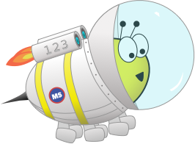

Year 5
Spring Block 2: Fractions
Lesson 6: To be able to compare and order improper fractions and mixed numbers
Spring
Block 2 – Fractions
6

Slide 2
To be able to compare and order improper fractions and mixed numbers
Success criteria:
I can apply my equivalent fractions knowledge by comparing and ordering fractions greater than 1 – both in improper fraction and mixed number form -that have common multiple denominators
I can explain my reasoning when applying my equivalent fractions knowledge by comparing and ordering fractions greater than 1 – both in improper fraction and mixed number form -that have common multiple denominators

Slide 3
To be able to compare and order improper fractions and mixed numbers
Starter:
What’s the same? What’s different?
Explain your answer.

Slide 4
To be able to compare and order improper fractions and mixed numbers
Starter:
What’s the same? What’s different?
All of the cubes are made from eight smaller cubes and both sets of cubes have one larger cube filled in; however, the yellow representation shows one whole cube and three eighths of a cube, whereas the purple representation shows one whole cube and five eighths of a cube.

Slide 5




To be able to compare and order improper fractions and mixed numbers
Talking Time:
Use the bar models below to compare $5/4$ and $3/2$ .
$$\frac{5}{4}$$
$$\frac{3}{2}$$

Slide 6
To be able to compare and order improper fractions and mixed numbers
Talking Time:
Use the bar models below to compare $5/4$ and $3/2$ .
$$\frac{5}{4}$$
$$\frac{3}{2}$$

Slide 7
To be able to compare and order improper fractions and mixed numbers
Talking Time:
Use the bar models below to compare $5/4$ and $3/2$ .
$$\frac{5}{4}$$
$$\frac{3}{2}$$

Slide 8
To be able to compare and order improper fractions and mixed numbers
Talking Time:
Use the bar models below to compare $5/4$ and $3/2$ .
$$\frac{5}{4}$$
<
$$\frac{3}{2}$$

Slide 9



To be able to compare and order improper fractions and mixed numbers
Talking Time:
Use the bar models below to compare $4/3$ and ${11}/6$ .
$$\frac{4}{3}$$
$$\frac{11}{6}$$

Slide 10
To be able to compare and order improper fractions and mixed numbers
Talking Time:
Use the bar models below to compare $4/3$ and ${11}/6$ .
$$\frac{4}{3}$$
$$\frac{11}{6}$$

Slide 11
To be able to compare and order improper fractions and mixed numbers
Talking Time:
Use the bar models below to compare $4/3$ and ${11}/6$ .
$$\frac{4}{3}$$
$$\frac{11}{6}$$

Slide 12
To be able to compare and order improper fractions and mixed numbers
Talking Time:
Use the bar models below to compare $4/3$ and ${11}/6$ .
$$\frac{4}{3}$$
<
$$\frac{11}{6}$$

Slide 13


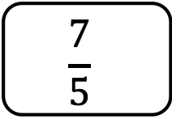
To be able to compare and order improper fractions and mixed numbers
Talking Time:
Use the bar models below to compare $7/5$ and ${17}/{10}$ .
$$\frac{7}{5}$$
$$\frac{17}{10}$$

Slide 14
To be able to compare and order improper fractions and mixed numbers
Talking Time:
Use the bar models below to compare $7/5$ and ${17}/{10}$ .
$$\frac{7}{5}$$
$$\frac{17}{10}$$

Slide 15
To be able to compare and order improper fractions and mixed numbers
Talking Time:
Use the bar models below to compare $7/5$ and ${17}/{10}$ .
$$\frac{7}{5}$$
$$\frac{17}{10}$$

Slide 16
To be able to compare and order improper fractions and mixed numbers
Talking Time:
Use the bar models below to compare $7/5$ and ${17}/{10}$ .
$$\frac{7}{5}$$
<
$$\frac{17}{10}$$

Slide 17



To be able to compare and order improper fractions and mixed numbers
Talking Time:
Use the bar models below to compare ${17}/{12}$ and $7/4$ .
$$\frac{17}{12}$$
$$\frac{7}{4}$$

Slide 18
To be able to compare and order improper fractions and mixed numbers
Talking Time:
Use the bar models below to compare ${17}/{12}$ and $7/4$ .
$$\frac{17}{12}$$
$$\frac{7}{4}$$

Slide 19
To be able to compare and order improper fractions and mixed numbers
Talking Time:
Use the bar models below to compare ${17}/{12}$ and $7/4$ .
$$\frac{17}{12}$$
$$\frac{7}{4}$$

Slide 20
To be able to compare and order improper fractions and mixed numbers
Talking Time:
Use the bar models below to compare ${17}/{12}$ and $7/4$ .
$$\frac{17}{12}$$
<
$$\frac{7}{4}$$

Slide 21






To be able to compare and order improper fractions and mixed numbers
Activity 1:
Use bar models to compare the following:
.
.
.
$$\frac{5}{3}$$
$$\frac{7}{6}$$
$$\frac{4}{3}$$
$$\frac{17}{12}$$
$$\frac{7}{4}$$
$$\frac{15}{8}$$

Slide 22
To be able to compare and order improper fractions and mixed numbers
Activity 1:
Use bar models to compare the following:
.
.
.
$$\frac{5}{3}$$
>
$$\frac{7}{6}$$
$$\frac{4}{3}$$
<
$$\frac{17}{12}$$
$$\frac{7}{4}$$
<
$$\frac{15}{8}$$

Slide 23

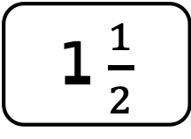
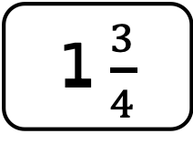
To be able to compare and order improper fractions and mixed numbers
Talking Time:
Use the bar models below to compare 1$3/4$ and 1$1/2$ .
1 $\frac{3}{4}$
1 $\frac{1}{2}$

Slide 24
To be able to compare and order improper fractions and mixed numbers
Talking Time:
Use the bar models below to compare 1$3/4$ and 1$1/2$ .
1 $\frac{3}{4}$
1 $\frac{1}{2}$

Slide 25
To be able to compare and order improper fractions and mixed numbers
Talking Time:
Use the bar models below to compare 1$3/4$ and 1$1/2$ .
1 $\frac{3}{4}$
1 $\frac{1}{2}$

Slide 26
To be able to compare and order improper fractions and mixed numbers
Talking Time:
Use the bar models below to compare 1$3/4$ and 1$1/2$ .
1 $\frac{3}{4}$
<
1 $\frac{1}{2}$

Slide 27


To be able to compare and order improper fractions and mixed numbers
Talking Time:
Use the bar models below to compare 1$3/8$ and 1$1/2$ .
1 $\frac{3}{8}$
1 $\frac{1}{2}$

Slide 28
To be able to compare and order improper fractions and mixed numbers
Talking Time:
Use the bar models below to compare 1$3/8$ and 1$1/2$ .
1 $\frac{3}{8}$
1 $\frac{1}{2}$

Slide 29
To be able to compare and order improper fractions and mixed numbers
Talking Time:
Use the bar models below to compare 1$3/8$ and 1$1/2$ .
1 $\frac{3}{8}$
1 $\frac{1}{2}$

Slide 30
To be able to compare and order improper fractions and mixed numbers
Talking Time:
Use the bar models below to compare 1$3/8$ and 1$1/2$ .
1 $\frac{3}{8}$
>
1 $\frac{1}{2}$

Slide 31


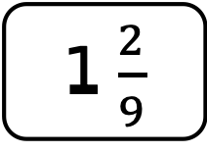
To be able to compare and order improper fractions and mixed numbers
Talking Time:
Use the bar models below to compare 1$2/9$ and 1$1/3$ .
1 $\frac{2}{9}$
1 $\frac{1}{3}$

Slide 32
To be able to compare and order improper fractions and mixed numbers
Talking Time:
Use the bar models below to compare 1$2/9$ and 1$1/3$ .
1 $\frac{2}{9}$
1 $\frac{1}{3}$

Slide 33
To be able to compare and order improper fractions and mixed numbers
Talking Time:
Use the bar models below to compare 1$2/9$ and 1$1/3$ .
1 $\frac{2}{9}$
1 $\frac{1}{3}$

Slide 34
To be able to compare and order improper fractions and mixed numbers
Talking Time:
Use the bar models below to compare 1$2/9$ and 1$1/3$ .
1 $\frac{2}{9}$
<
1 $\frac{1}{3}$

Slide 35
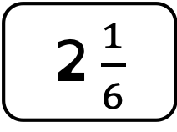
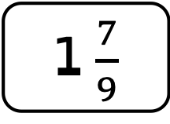
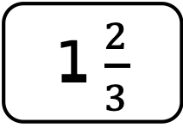


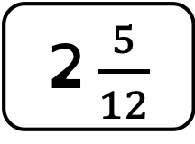
To be able to compare and order improper fractions and mixed numbers
Activity 2:
Use bar models to compare the following:
.
.
.
1 $\frac{7}{8}$
1 $\frac{1}{4}$
1 $\frac{2}{3}$
1 $\frac{7}{9}$
2 $\frac{1}{6}$
2 $\frac{5}{12}$

Slide 36
To be able to compare and order improper fractions and mixed numbers
Activity 2:
Use bar models to compare the following:
.
.
.
1 $\frac{7}{8}$
>
1 $\frac{1}{4}$
1 $\frac{2}{3}$
<
1 $\frac{7}{9}$
2 $\frac{1}{6}$
<
2 $\frac{5}{12}$

Slide 37

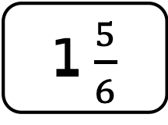

To be able to compare and order fractions
Talking Time:
Re-arrange the following mixed numbers in order from smallest to greatest.
1 $\frac{1}{2}$
1 $\frac{5}{6}$
1 $\frac{1}{3}$

Slide 38
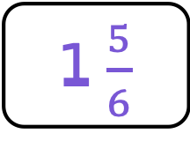
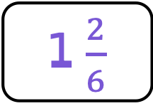

To be able to compare and order fractions
Talking Time:
Re-arrange the following mixed numbers in order from smallest to greatest.
1 $\frac{1}{2}$
1 $\frac{5}{6}$
1 $\frac{1}{3}$
× 3
× 2
1 $\frac{3}{6}$
1 $\frac{5}{6}$
1 $\frac{2}{6}$

Slide 39
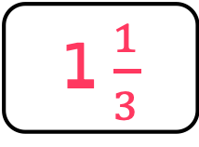
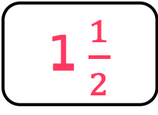

To be able to compare and order fractions
Talking Time:
Re-arrange the following mixed numbers in order from smallest to greatest.
1 $\frac{1}{2}$
1 $\frac{5}{6}$
1 $\frac{1}{3}$
× 3
× 2
1 $\frac{3}{6}$
1 $\frac{5}{6}$
1 $\frac{2}{6}$
1 $\frac{1}{3}$
1 $\frac{1}{2}$
1 $\frac{5}{6}$

Slide 40
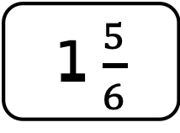
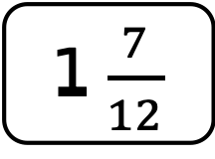

To be able to compare and order fractions
Talking Time:
Re-arrange the following mixed numbers in order from smallest to greatest.
1 $\frac{5}{6}$
1 $\frac{7}{12}$
1 $\frac{3}{4}$

Slide 41
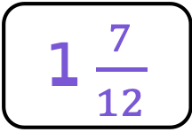
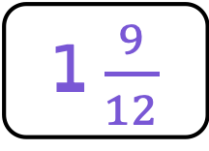
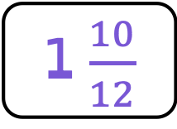
To be able to compare and order fractions
Talking Time:
Re-arrange the following mixed numbers in order from smallest to greatest.
1 $\frac{5}{6}$
1 $\frac{7}{12}$
1 $\frac{3}{4}$
× 2
× 3
1 $\frac{10}{12}$
1 $\frac{7}{12}$
1 $\frac{9}{12}$

Slide 42
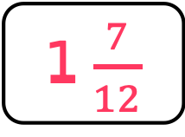
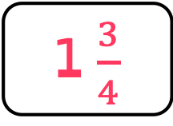
To be able to compare and order fractions
Talking Time:
Re-arrange the following mixed numbers in order from smallest to greatest.
1 $\frac{5}{6}$
1 $\frac{7}{12}$
1 $\frac{3}{4}$
× 2
× 3
1 $\frac{10}{12}$
1 $\frac{7}{12}$
1 $\frac{9}{12}$
1 $\frac{7}{12}$
1 $\frac{3}{4}$
1 $\frac{5}{6}$

Slide 43
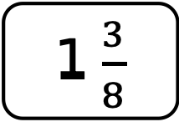
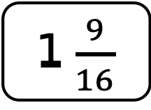

To be able to compare and order fractions
Talking Time:
Re-arrange the following mixed numbers in order from smallest to greatest.
1 $\frac{3}{8}$
1 $\frac{9}{16}$
1 $\frac{1}{4}$

Slide 44
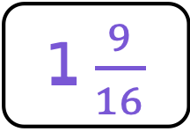
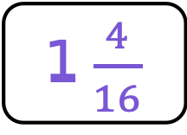

To be able to compare and order fractions
Talking Time:
Re-arrange the following mixed numbers in order from smallest to greatest.
1 $\frac{3}{8}$
1 $\frac{9}{16}$
1 $\frac{1}{4}$
× 2
× 4
1 $\frac{6}{16}$
1 $\frac{9}{16}$
1 $\frac{4}{16}$

Slide 45
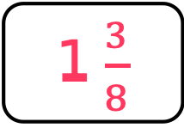
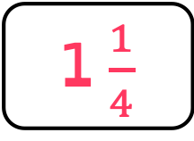
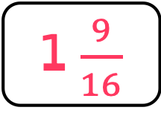
To be able to compare and order fractions
Talking Time:
Re-arrange the following mixed numbers in order from smallest to greatest.
1 $\frac{3}{8}$
1 $\frac{9}{16}$
1 $\frac{1}{4}$
× 2
× 4
1 $\frac{6}{16}$
1 $\frac{9}{16}$
1 $\frac{4}{16}$
1 $\frac{3}{8}$
1 $\frac{1}{4}$
1 $\frac{9}{16}$

Slide 46
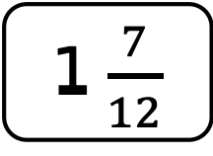
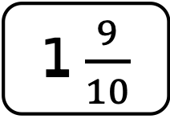

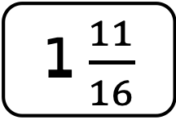



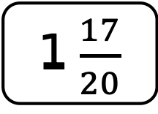

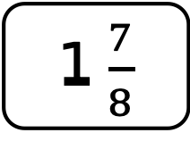


To be able to compare and order fractions
Activity 3:
Re-arrange the following mixed numbers in order from smallest to greatest.
.
.
.
.
1 $\frac{7}{8}$
1 $\frac{1}{2}$
1 $\frac{3}{4}$
1 $\frac{2}{3}$
1 $\frac{3}{4}$
1 $\frac{7}{12}$
1 $\frac{7}{8}$
1 $\frac{11}{16}$
1 $\frac{3}{4}$
1 $\frac{9}{10}$
1 $\frac{17}{20}$
1 $\frac{3}{5}$

Slide 47












To be able to compare and order fractions
Activity 3:
Re-arrange the following mixed numbers in order from smallest to greatest.
.
.
.
.
1 $\frac{1}{2}$
1 $\frac{3}{4}$
1 $\frac{7}{8}$
1 $\frac{7}{12}$
1 $\frac{2}{3}$
1 $\frac{3}{4}$
1 $\frac{11}{16}$
1 $\frac{3}{4}$
1 $\frac{7}{8}$
1 $\frac{3}{5}$
1 $\frac{17}{20}$
1 $\frac{9}{10}$

Slide 48
To be able to compare and order fractions
Activity 4:
Ruth and Yasmin have two of the same cakes each.
Ruth says, “I have cut both of my cakes into ten equal slices and sold thirteen slices.”
Yasmin says, “I have cut both of my cakes into five equal slices and sold nine slices.”
Who has sold the most cake?
Explain your answer.

Slide 49

To be able to compare and order fractions
Activity 4:
Ruth and Yasmin have two of the same cakes each.
Ruth says, “I have cut both of my cakes into ten equal slices and sold thirteen slices.”
Yasmin says, “I have cut both of my cakes into five equal slices and sold nine slices.”
Yasmin has sold the most cake as $\frac{18}{10}$ is greater than $\frac{13}{10}$.

Slide 50

To be able to compare and order improper fractions and mixed numbers
Evaluation:
Do you agree?
Provide bar models to explain your answer.
1½ is smaller than 1$3/{10}$ because the numerator and denominator in the first fraction are smaller.

Slide 51
To be able to compare and order improper fractions and mixed numbers
Evaluation:
No, I do not agree.
A half is equivalent to five tenths as a fraction with a numerator over ten. Both mixed numbers have one whole and therefore 1 as an integer. Once converted, it is clear that half is a greater fraction than three tenths, as the bar models show.
1½ is smaller than 1$3/{10}$ because the numerator and denominator in the first fraction are smaller.

Slide 52
To be able to compare and order improper fractions and mixed numbers
Success criteria:
I can apply my equivalent fractions knowledge by comparing and ordering fractions greater than 1 – both in improper fraction and mixed number form -that have common multiple denominators
I can explain my reasoning when applying my equivalent fractions knowledge by comparing and ordering fractions greater than 1 – both in improper fraction and mixed number form -that have common multiple denominators

