Slide 1
Year 1 and Year 2
Reading Quick Start

Slide 2
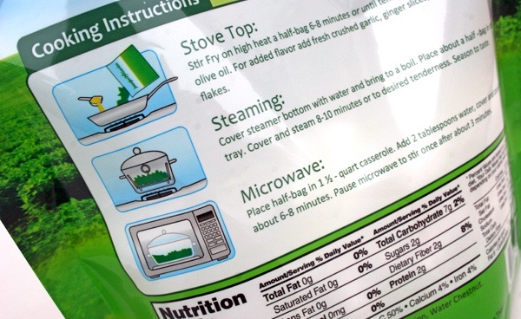
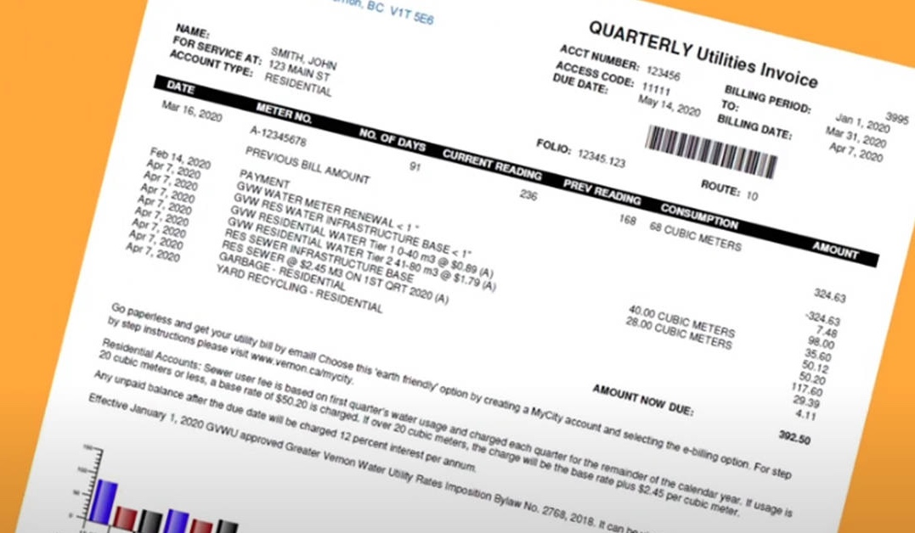
How many times have you already read today?

Slide 3
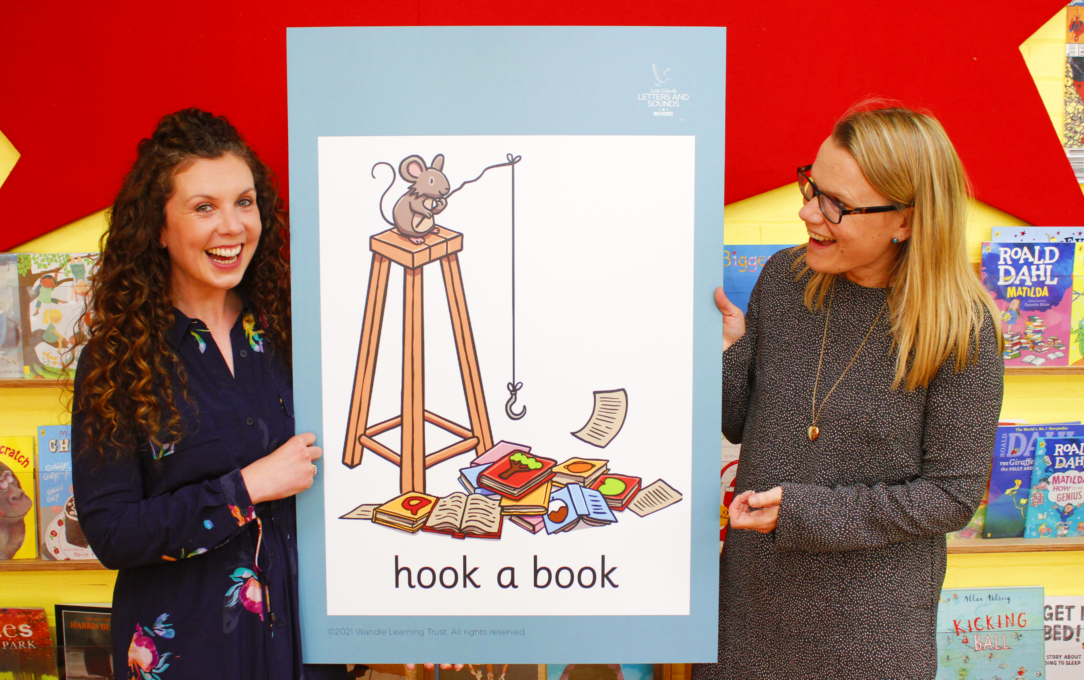
Little Wandle Letters and Sounds Revised
Our school has chosen Little Wandle Letters and Sounds Revised as our systematic, synthetic phonics (SSP) programme to teach early reading and spelling.

Slide 4
Blending to read words

Slide 5
Terminology
Phoneme
Split vowel digraph
Grapheme
Blend
Digraph
Segment
Trigraph

Slide 6
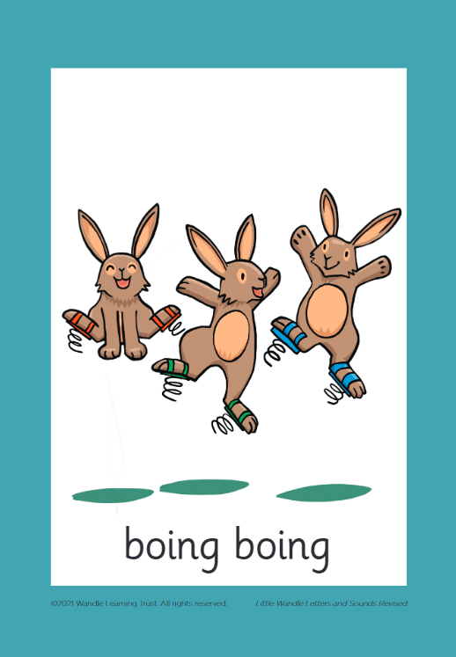
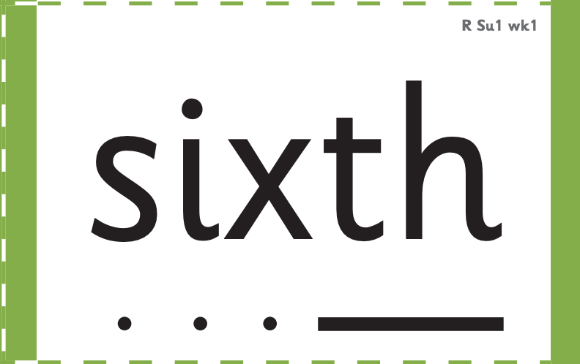
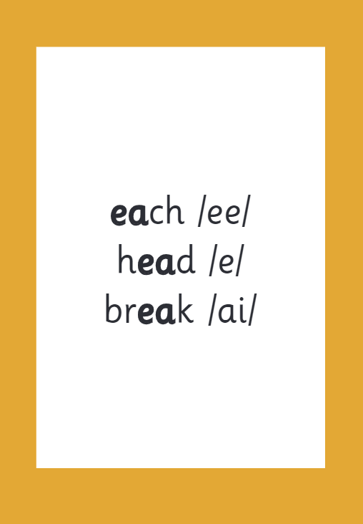
How we make learning stick

Slide 7
Reading and spelling
Notes:
This is an example of what the children learn in Year 1.
Children learn that there are graphemes that can have different sounds and sounds that can be made with different letters.
Use the backs and fronts of Phase 5 cards to show ‘ea’ and ‘ow’.

Slide 8
And all the different ways to write the phoneme sh:
shell
chef
special
caption
mansion
passion

Slide 9
Tricky words
Notes:
Have a look at this video on the website: https://www.littlewandlelettersandsounds.org.uk/resources/for-parents/

Slide 10
Spelling
Say the word.
Segment the sounds.
Count the sounds.
Write them down.
Notes:
Model the process on a flipchart for the parents to see.

Slide 11
How do we teach reading in books?
Reading practice sessions are:
timetabled three times a week
taught by a trained teacher/teaching assistant
taught in small groups.
Notes:
The children read the same book three times in a week. The first time we work on decoding (sounding out) the words, the second time we work on prosody which is reading with expression – making the book sound more interesting with our story-teller voice or our David Attenborough voice – and the third time we look at comprehension. We read the books three times at school because we want to develop the fluency. The more they see words the more they begin to read them automatically without having to sound them out.

Slide 12
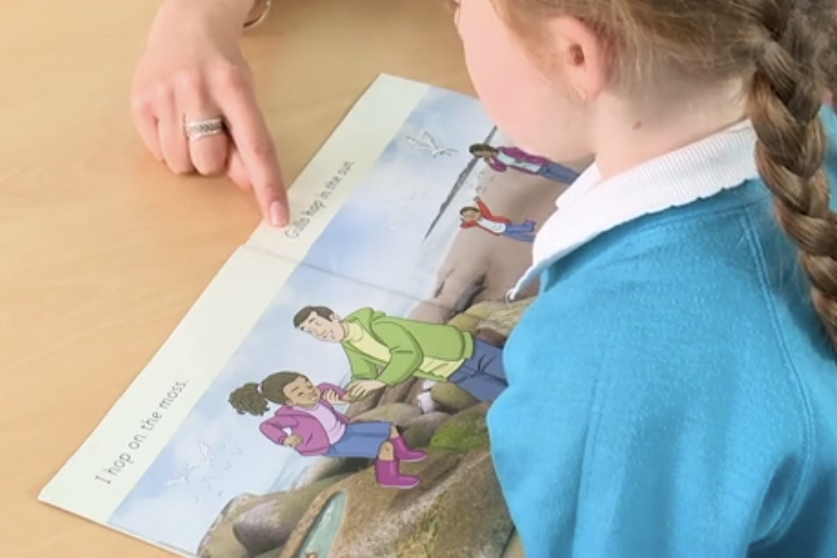
Reading a book at the right level
This means that your child should:
Know all the sounds and tricky words in their phonics book well
Read many of the words by silent blending (in their head) – their reading will be automatic
Only need to stop and sound out about 5% of the words by the time they bring the book home – but they should be able to do this on their own.

Slide 13
Reading at home
Reading at home

Slide 14
The most important thing you can do is read with your child
Reading a book and chatting had a positive impact a year later on children’s ability to…
understand words and sentences
use a wide range of vocabulary
develop listening comprehension skills.
The amount of books children were exposed to by age 6 was a positive predictor of their reading ability two years later.
Parental involvement in the development of children’s reading skills: A five-year longitudinal study (2002) Senechal, M. and Lefvre, J
Notes:
Celebrate child’s success at school, make time for reading at home!

Slide 15
Listening to your child read their phonics book
Your child should be able to read their book without your help.
If they can’t read a word read it to them.
Talk about the book and celebrate their success.

Slide 16
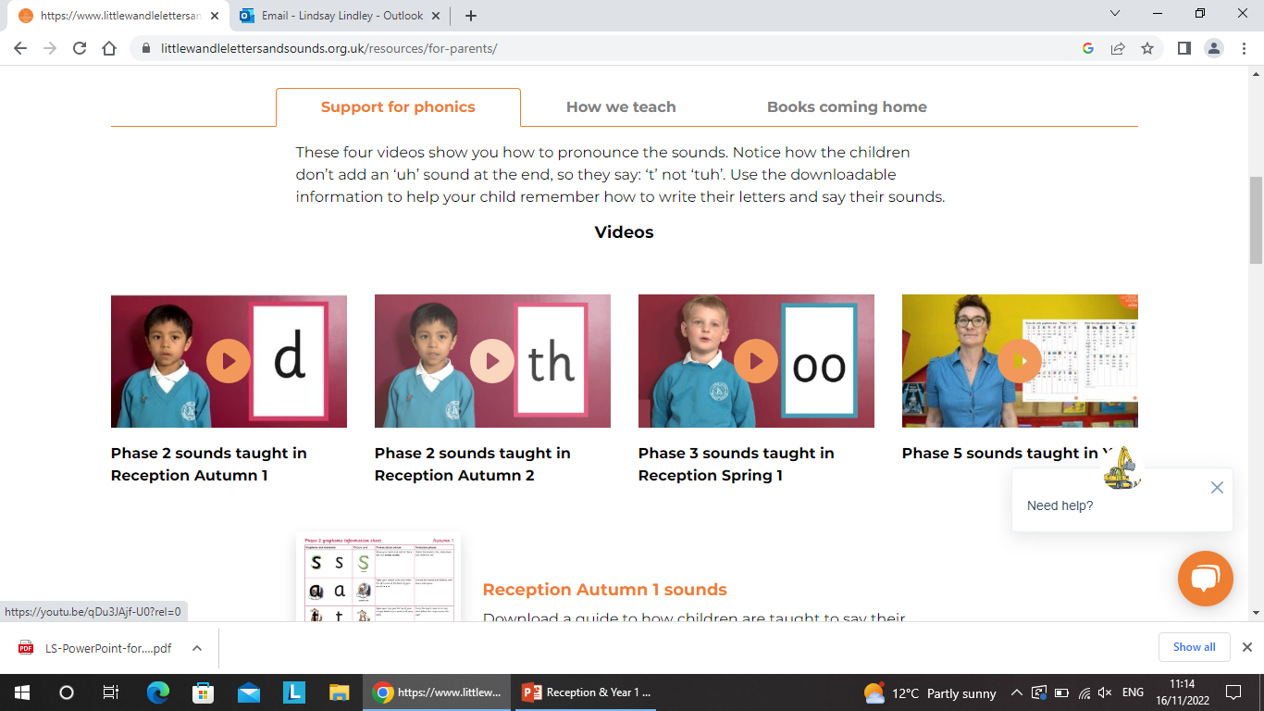
Parent support from Little Wandle

Slide 17
Developing a life long relationship with books and reading
Love of Reading
DEAR – Drop Everything and Read
Whole Class Reading

Slide 18
Phonics Screening Check
The Phonics Screening is a statutory assessment for all Year 1 children.
The screening takes place in June of each year.
It consists of 40 words. 20 real words and 20 ‘nonsense words’ that children have to decode and blend.
Pass has been 32/40 but this may change
1:1 assessment

Slide 19
Year 2 Reading SATs
At the end of KS1 the children will complete a reading paper. Through the work done with our Reading Vipers children are taught reading comprehension skills to help them make sense of the text:
Read the text carefully
Read the question
Highlight the keywords in the question
Scan read the text looking for the key words
Write the answer

