Slide 1
The Love of Reading
Year 3 and Year 4

Slide 2
What will the school do to develop reading:
We will provide the children with a wide range of books to read at home at an appropriate level to aid their reading development.
We will give children the opportunity to change their book regularly.
We will read and give extra support to our children.

Slide 3
Year 3 and 4 will teach and assess reading through:
Promoting a love of reading through various activities
DEAR sessions
Whole Class Reading sessions
The teaching of VIPERS
Cracking Comphrension scheme
The teaching of spelling patterns
Reading comphrension tests

Slide 4
What skills will your child need to be a good reader?
Vocabulary – to explain the meaning of a word
Infer – make inferences from the text to explain and justify evidence from the text
Predict – to predict what might happen from details stated
Explain – to make comparisons and connections between the text
Retrieval – to retrieve and record information
Summarise – to summarise main ideas in the text

Slide 5
How do we monitor progress and attainment:
Termly NFER and PIRA test
Teaching of Cracking Comphrension scheme
WCR daily sessions
Weekly spelling tests
Continuous home reading book monitoring

Slide 6
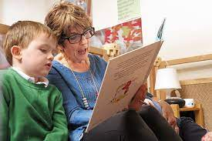
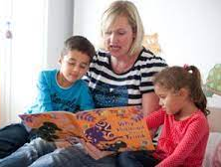
What difference could I make as a parent or career?
Parents and carers are by far the most important educators in a child’s life. It is never too young for a child to start, even if you’re only reading with your child for a few minutes a day. It has been found that reading to an adult and talking about the text for only 10 minutes a day, makes a significant impact on reading development.

Slide 7
What we ask of parents and careers:
We ask you listen to your children read at least three times a week.
Please fill in their reading record each time they read.
Make sure your child had their reading record and book everyday in school.
Encourage your child to read a variety of sources.
Please talk to us about reading and ask if you are unsure.

Slide 8
Thank you.
Any Questions?

