Slide 1
Quick Start Reading Meeting
Year 5 and Year 6
November 2022

Slide 3
Reading is one of our main priorities at Whinmoor St Paul’s Primary School. It is a skill which strengthens a child’s gifts to access the wider curriculum and allows them to expand their vocabulary and develop vivid imaginations. To ensure the children at Whinmoor St Paul’s Primary School are given the best opportunity to succeed, we ensure that pupils are given daily teaching of reading that builds on fluency and comprehension skills.

Slide 4
What are we doing to help develop reading:
- We will provide the children with a wide range of books to read at home of an appropriate level to aid their reading development
- Opportunities to change books for new ones
Reading interventions and extra support
Love of Reading lessons
Daily Whole Class Reading sessions
D.E.A.R (Drop Everything and Read)
Playground library boxes
In Year 5 and Year 6 we will teach and assess reading through:
-Promoting a love of reading through activities such as reading stories, author studies, library visits, competitions, themed days
-Whole Class Reading- through a variety of texts
- Teaching focusing on a class novel- you can find these on our reading spines on our school webpage
- Cracking Comprehension scheme
- Reading Comprehension tests

Slide 5
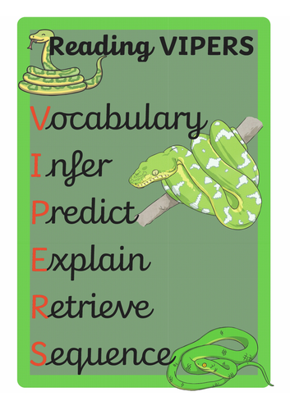
Whole Class Reading
You may have heard your child using the term ‘Reading VIPERS’ and wondered what snakes have to do with reading! This is a mnemonic we use at school to cover the key comprehension skills that we teach as part of the National Curriculum.
We use the term ‘Reading VIPERS’ to encourage children to actively think
about the comprehension skills they are using when they read. These are:
V - Vocabulary
I - Infer
P - Predict
E - Explain
R - Retrieve
S - Summarise (KS2)
Comprehension lessons are teacher led and focus on teaching the skill of reading through discussion of skills and teacher modelling.

Slide 6
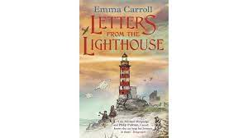
Practical session.
Whole Class Reading session.
What is choral?
What is echo?
What is jump in?

Slide 7
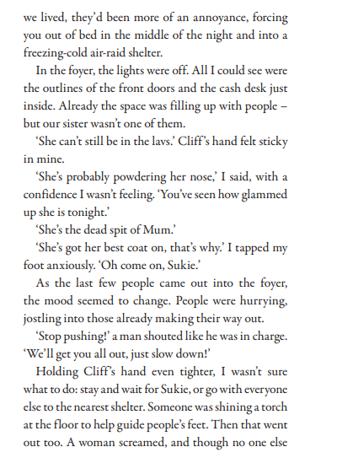

Slide 9
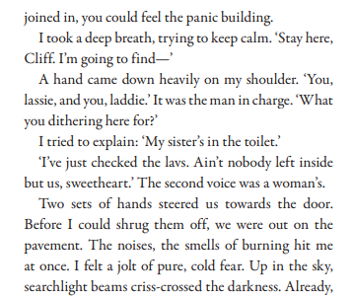

Slide 10
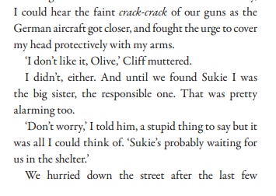

Slide 11
Question 1: What does it mean when it says someone is ‘the dead spit of Mum?’
Question 2: Why was the narrator tapping their foot anxiously?
Question 3: What do you think might have happened to Sukie?
Question 4: Explain why the children were heading to the shelter?
Question 5: What does someone use to guide the way in the dark?
Question 6: Use one word to describe the narrator. Why did you choose this word?

Slide 12
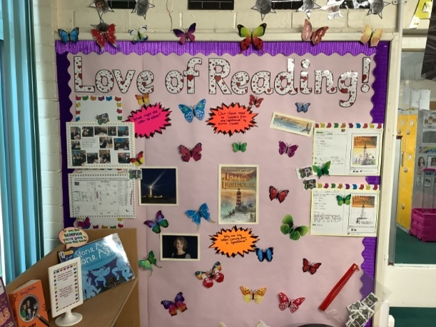
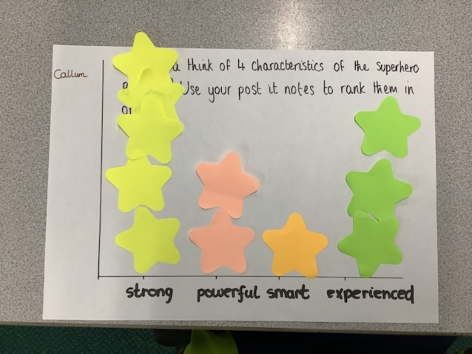
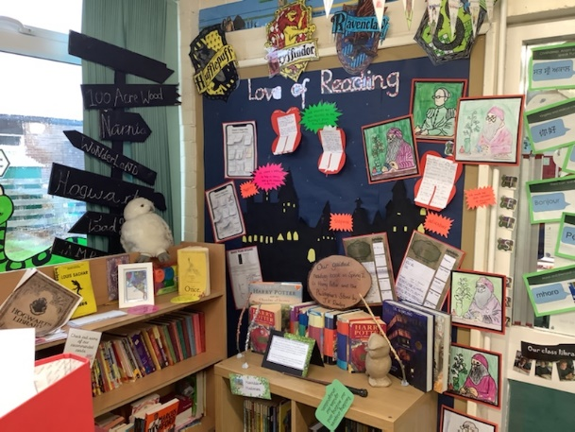
Love of Reading
We are passionate about developing children’s joy, pleasure and love of reading at Whinmoor St Paul’s.
In order to achieve this, we teach a weekly session related to our class novel and a Vipers skill which will develop a natural curiosity and intellectual interest in the books we study.

Slide 13
Home Reading Books
Your child has a banded reading book to take home.
Every half term, fluency and book banding checks are completed by the teacher to ensure your child in accessing the correct book for their ability.
It is vital your child’s reading is listened to at home to ensure they are getting additional practice. In addition to their reading book, remember, they can read ANYTHING!
We need your help to instil that love of reading.

Slide 14
What difference could I make as a parent or carer?
A LOT!
Parents and carers are by far the most important educators in a child's life. It's never too young for a child to start, even if you're only reading with your child for a few minutes a day. It has been found that reading to an adult and talking about the text for only ten minutes a day, makes a significant impact on reading development.

Slide 15
Building vocabulary and understanding:
Learning to read is about listening and understanding as well as working out print. From hearing and reading stories, children are exposed to a rich and wide vocabulary.
Different reading sources:
Find out what interests them and encourage them to find other reading materials or sources that will be engaging and fun such as comics, magazines and recipes!

Slide 16
What we ask of parents and carers:
- We ask that you listen to your child read at least three times a week for a minimum of ten minutes.
- Please talk to us about reading and ask us if unsure.
- Fill in your child's homework diary with details of the pages read and sign this on a weekly basis.
- Make sure your child has their reading book in school every day.

Slide 17
Be POSITIVE
Talk about
the book
Top tips!
Choose a quiet time.
Make it fun and enjoyable

Slide 18
Any questions?

