Slide 2
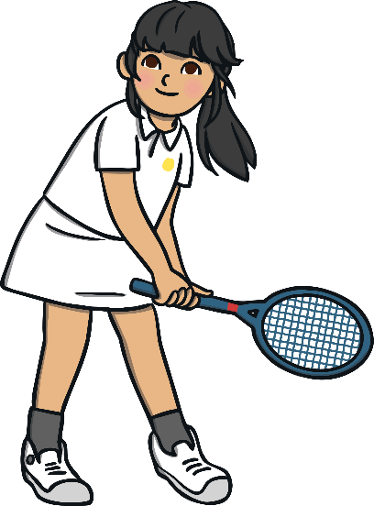
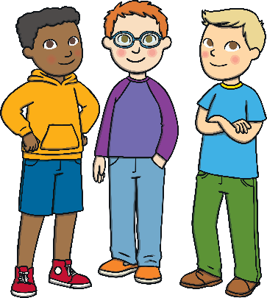
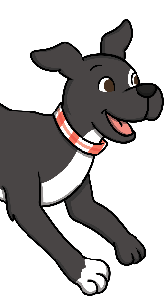
and
There are two types of conjunction: co-ordinating conjunctions and subordinating conjunctions. The conjunction ‘and’ is used in a sentence to join or link words, phrases or clauses together. It is a co-ordinating conjunction that can make a compound sentence.
Romario mowed the grass and his friends
helped him.
I like to play tennis and I love to walk my dog.
Danni will be eating doughnuts and she will be drinking a milkshake.

Slide 3
but
There are two types of conjunction: co-ordinating conjunctions and subordinating conjunctions. The conjunction ‘but’ is used in a sentence to join or link words, phrases or clauses together. It is a co-ordinating conjunction that can make a compound sentence.
James needed to wear sun cream but he had forgotten to pack it.
She likes apples but she doesn’t like pears.
The tiger was hungry but he was too tired to hunt.

Slide 4
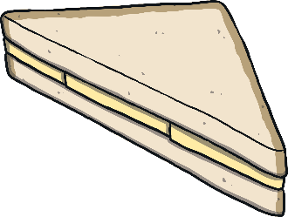
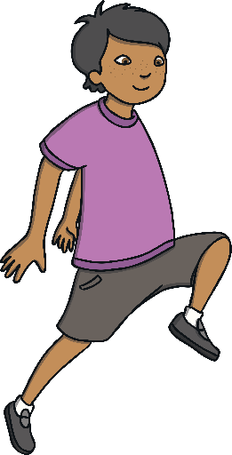
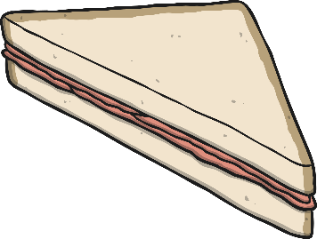
or
There are two types of conjunction: co-ordinating conjunctions and subordinating conjunctions. The conjunction ‘or’ is used in a sentence to join or link words, phrases or clauses together. It is a co-ordinating conjunction that can make a compound sentence.
Would you like a cheese or would you like a ham sandwich?
Nikita would love a pet dog or she might like a pet cat.
Noah could win the skipping race or Barnaby might win.

Slide 5
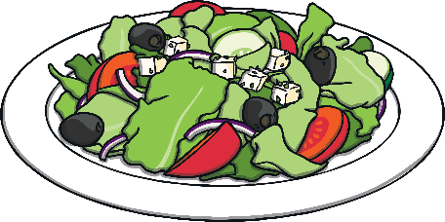
when
There are two types of conjunction: co-ordinating conjunctions and subordinating conjunctions. The conjunction ‘when’ can be used in the middle or at the beginning of a sentence to join two phrases or clauses. It is a subordinating conjunction that can make a complex sentence.
You can have a sticker when you have tried your best.
Cheng was happy when his family surprised him.
When I’ve finished my vegetables, please can I have a pudding?

Slide 6
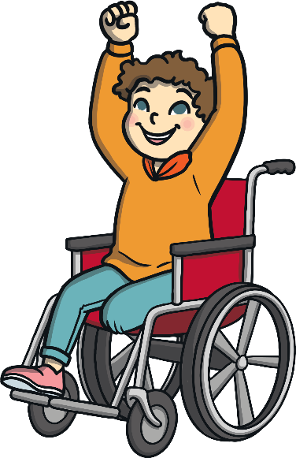
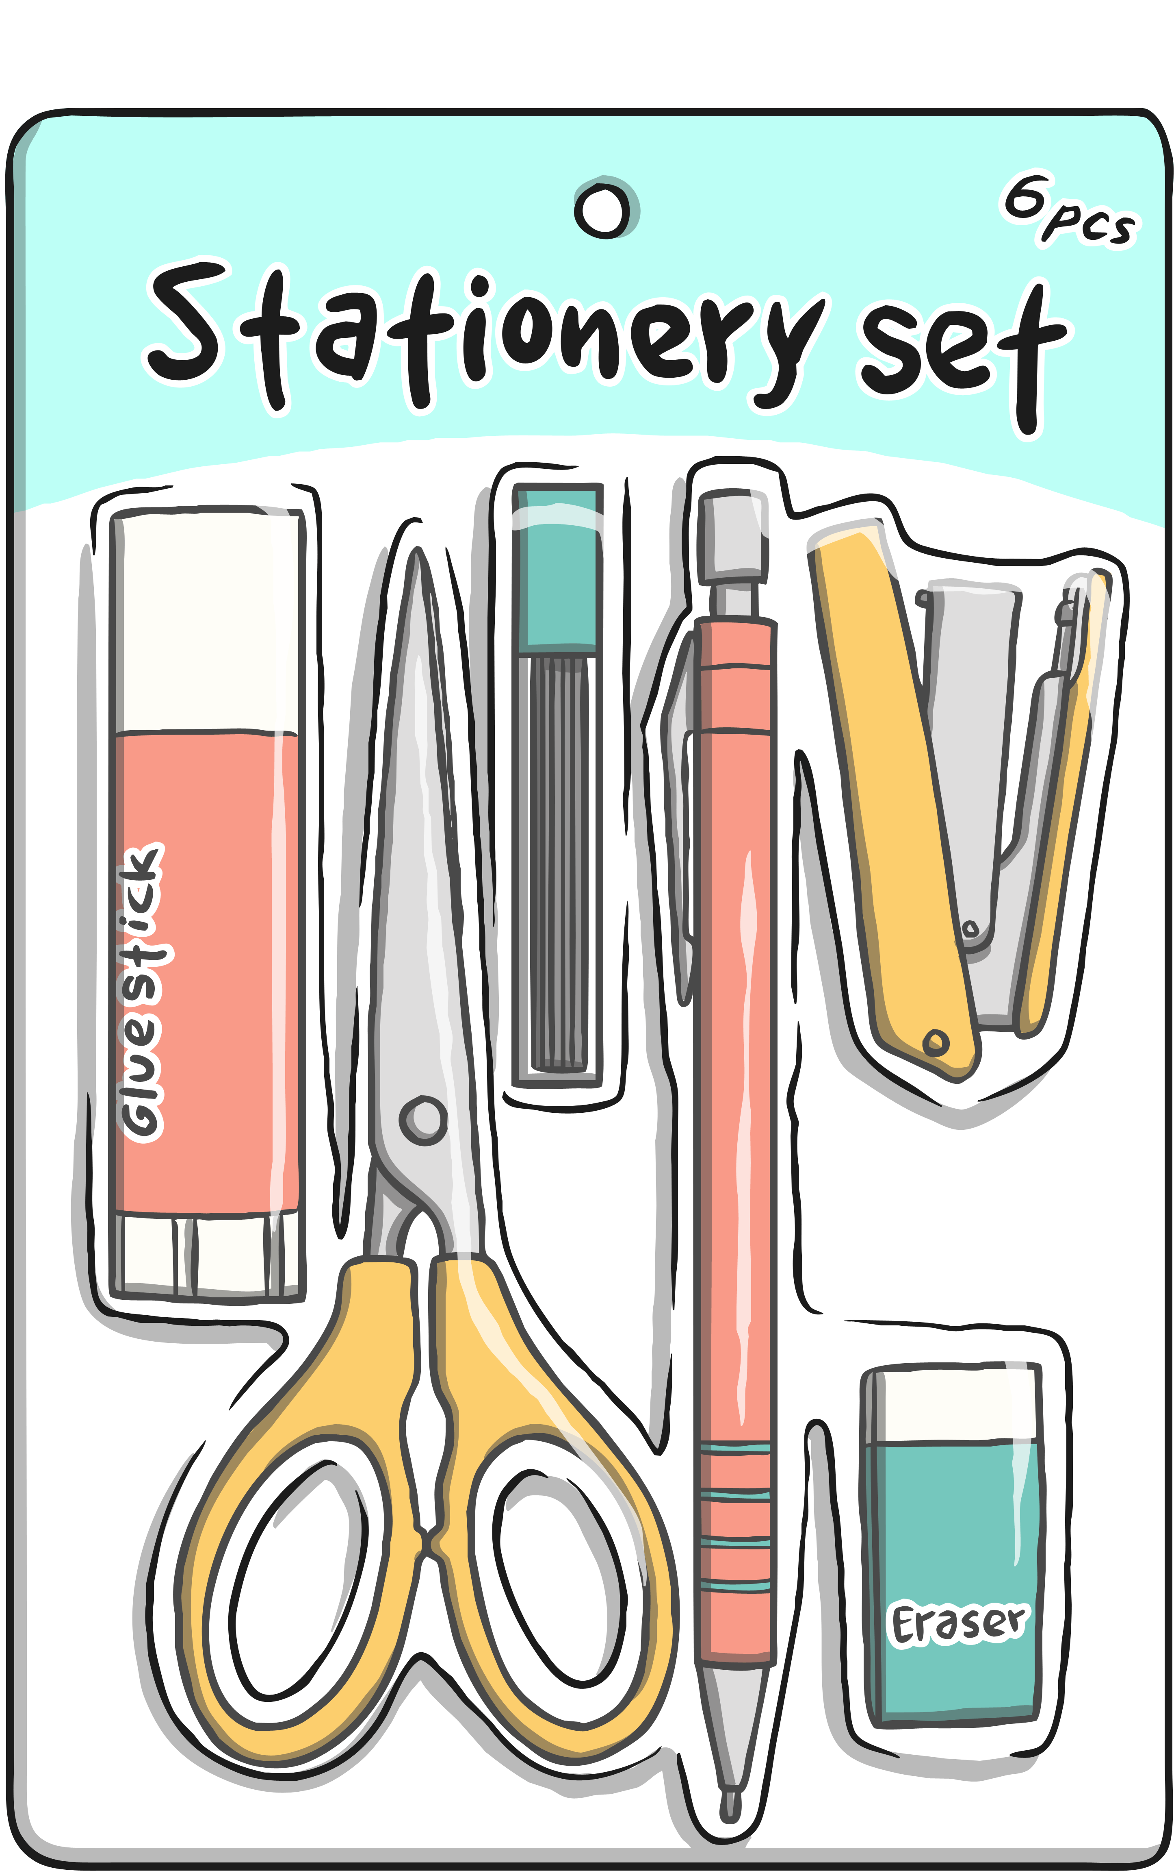
that
There are two types of conjunction: co-ordinating conjunctions and subordinating conjunctions. The conjunction ‘that’ can be used in the middle or at the beginning of a sentence to join two phrases or clauses. It is a subordinating conjunction that can make a complex sentence.
Thomas knows a great game that he is sure you will like.
George bought a new stationery pack that would be very useful
at school.
I stayed in a great hotel that had a fabulous swimming pool.

Slide 7
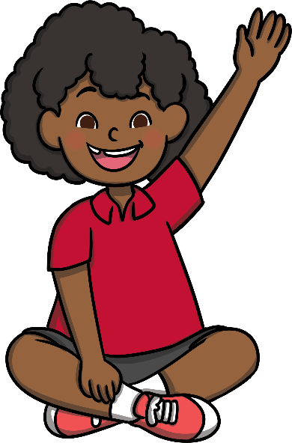
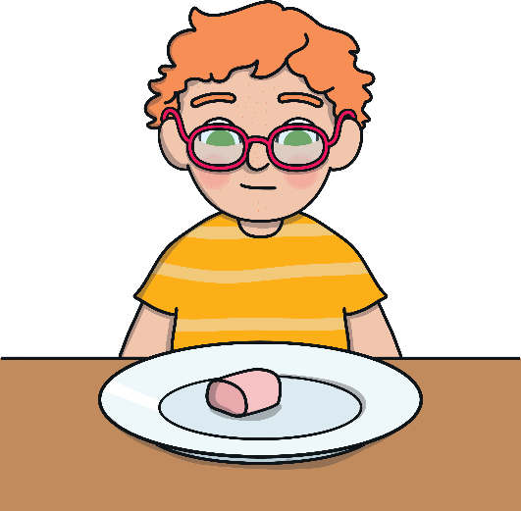
if
There are two types of conjunction: co-ordinating conjunctions and subordinating conjunctions. The conjunction ‘if’ can be used in the middle or at the beginning of a sentence to join two phrases or clauses. It is a subordinating conjunction that can make a complex sentence.
Put your hand up if you need me to help you.
The boy was allowed to have a pudding if he ate all his sprouts.
If you set off to school now, you will arrive on time.

Slide 8
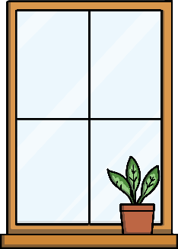
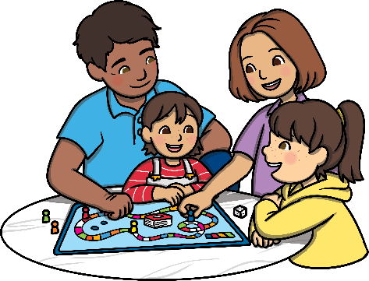
because
There are two types of conjunction: co-ordinating conjunctions and subordinating conjunctions. The conjunction ‘because’ can be used in the middle or at the beginning of a sentence to join two phrases or clauses. It is a subordinating conjunction that can make a complex sentence.
We played a board game because it was a rainy day.
Monika doesn’t drink milk because she is allergic to it.
I opened the door because someone had been knocking.

Slide 9
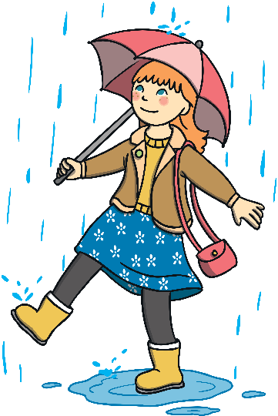
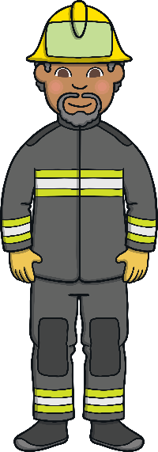
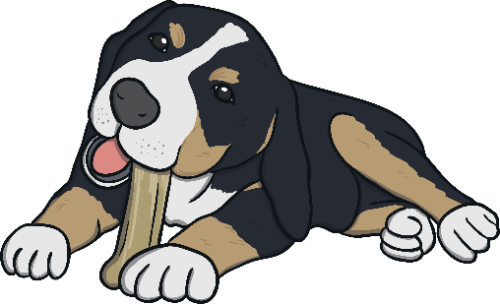
so
There are two types of conjunction: co-ordinating conjunctions and subordinating conjunctions. The conjunction 'so' is used in a sentence to join or link words, phrases or clauses together. It is a co-ordinating conjunction that can make a compound sentence.
She used an umbrella so she wouldn't get wet.
Max had been a good dog so he was given a bone.
He wanted to help people so he became a fireman.

