Slide 3
Are the groups equal or unequal?
2) Are the groups equal or unequal?
3) Complete the sentences.
There are groups.
There are in each group.
There are altogether.

Slide 4
Are the groups equal or unequal?
2) Are the groups equal or unequal?
3) Complete the sentences.
There are groups.
There are in each group.
There are altogether.
3
5
15

Slide 6
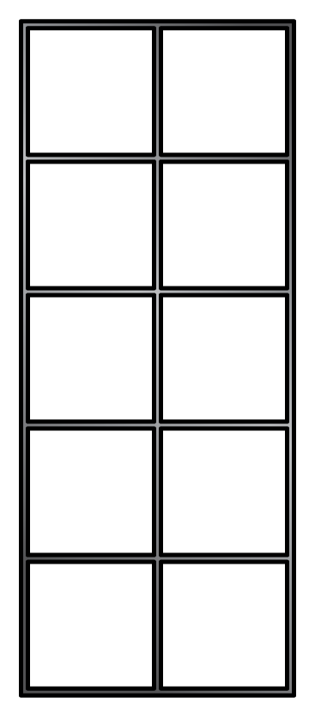
Complete the sentence.
4
There are equal groups with
in each group.
5

Slide 7
Complete the sentence.
3
There are equal groups with
in each group.
10
Have a think

Slide 8
Complete the sentence.
3
There are equal groups with
in each group.
10
Have a think

Slide 9
What’s the same? What’s different?
Complete the sentences.
Have a think
3
There are equal groups with
in each group.
5
5
There are equal groups with
in each group.
3

Slide 10
Match the pictures to the labels.
4 equal groups of 2
2 equal groups of 2
2 equal groups of 4
Have a think

Slide 11
Which picture matches the sentence?
3 groups of 5
Have a think

Slide 12
Have a go at questions 3 - 4 on the worksheet

Slide 13
Here are 12 counters.
Make 4 groups of 3
Have a think

Slide 14
Here are 12 counters.
Have a think
Make 3 groups of 4
What other equal groups could you make?
Have a think

Slide 15
Here are 12 counters.
12 groups of 1
2 groups of 6
6 groups of 2
1 group of 12
What other equal groups could you make?

Slide 16
How can you make the groups equal?
Add cubes to make 3 groups of 4
Is there more than one way?
Have a think

Slide 17
How can you make the groups equal?
Add cubes to make 3 groups of 4
Remove cubes to make 3 groups of 2

Slide 18
How can you make the groups equal?
Add cubes to make 3 groups of 4
Remove cubes to make 3 groups of 2
Move a cube to make 3 groups of 3

Slide 19
Have a go at the rest of the questions on the worksheet

Slide 21
I do
You do

Slide 22
Rosie
Alex
Amir
Whitney
Ron
Dexter
Annie
Tommy
Mo
Jack
Eva
Teddy
Max
Kim
Jo
Sam

Slide 23
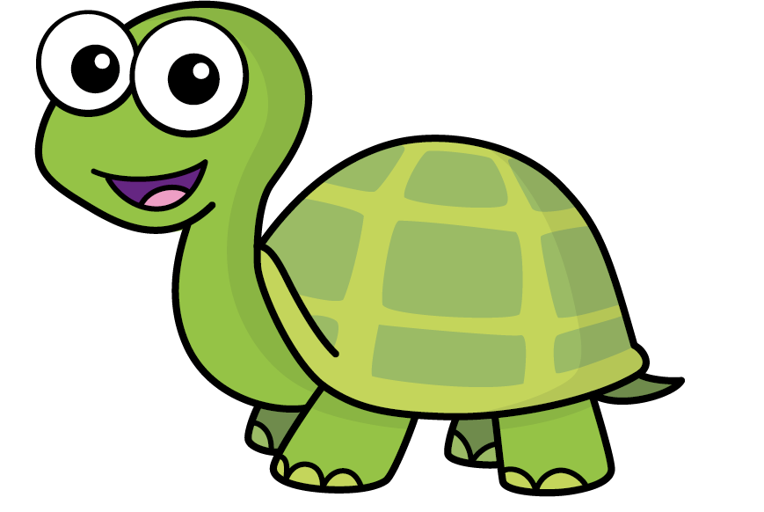
Speech bubble text – replace with any character head.
Speech bubble text – replace with any character head.
Bee
Diddy
Tiny

Slide 24
27
342
300
2
20
7
40
M | HTh | Tth | Th | H | T | O

Slide 25
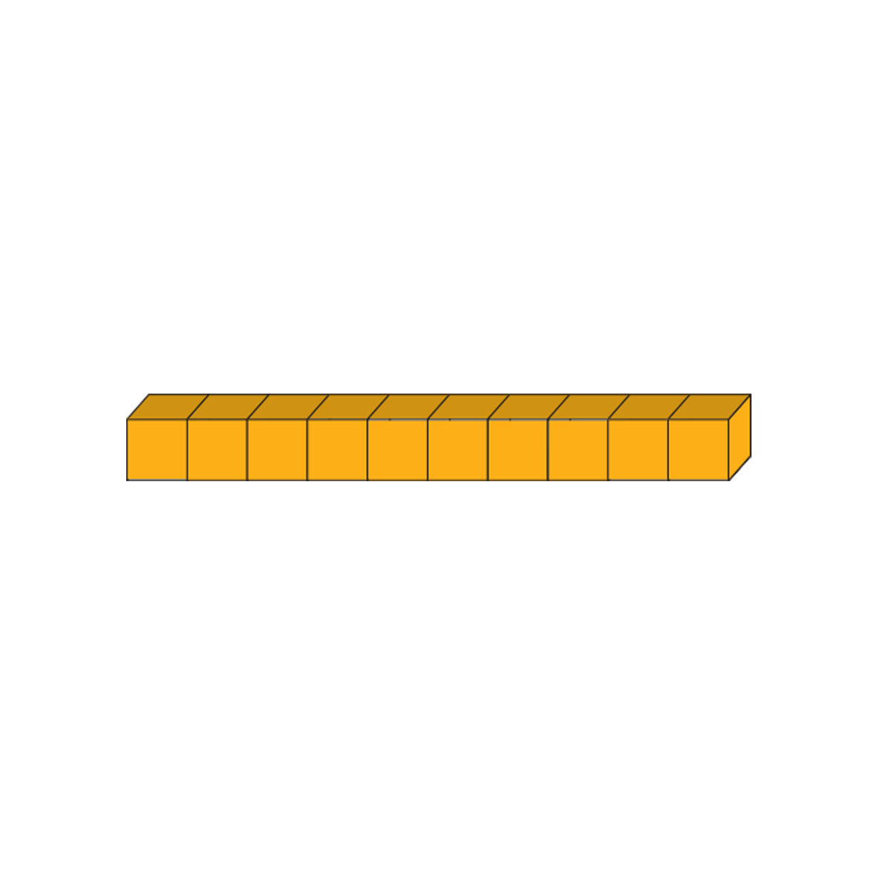
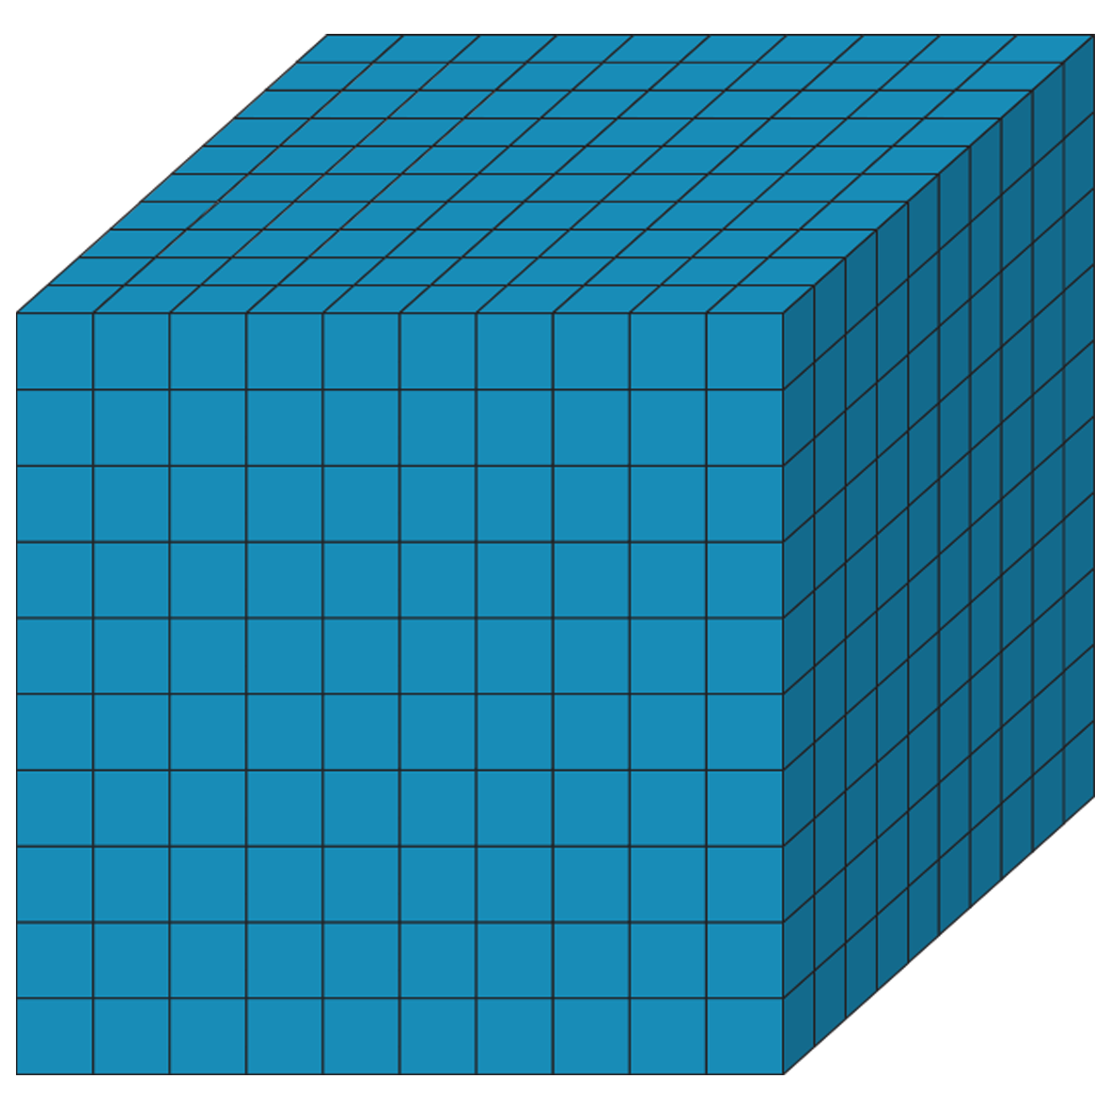
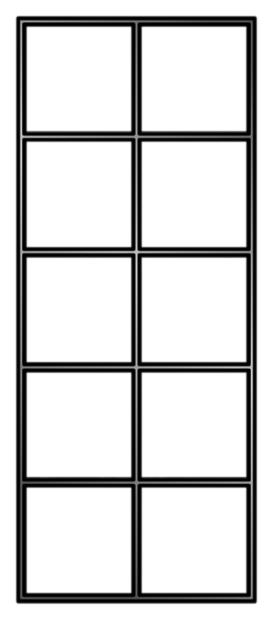
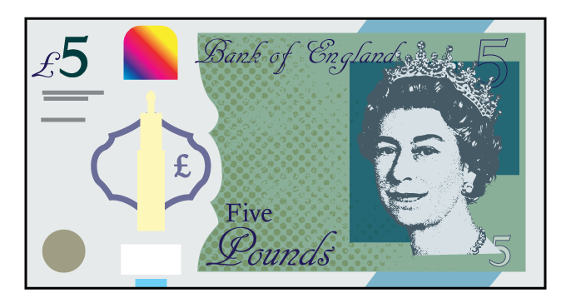
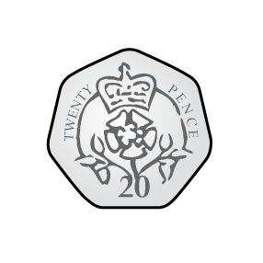
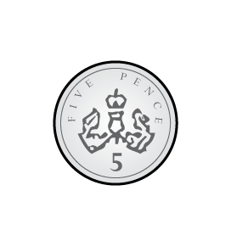
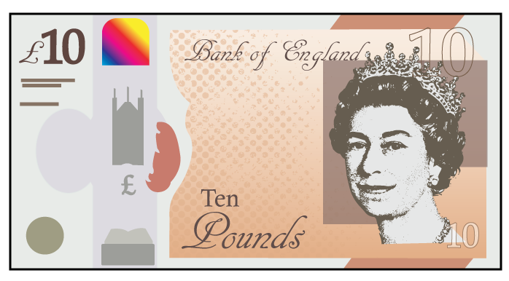
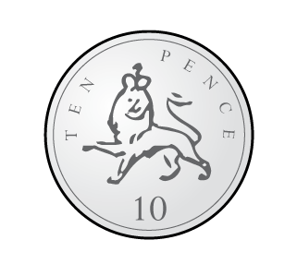
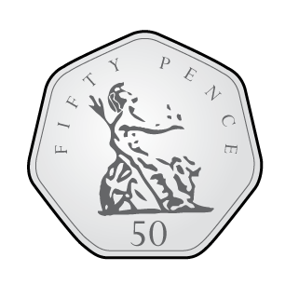
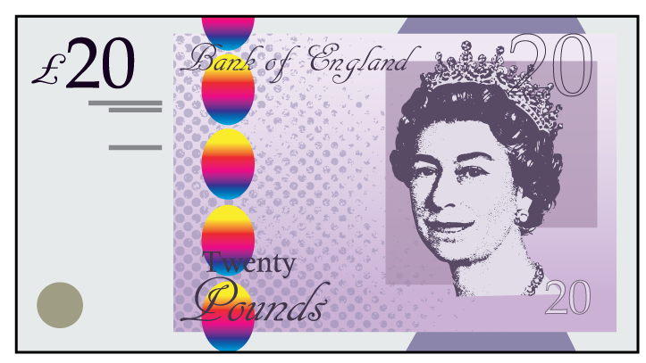
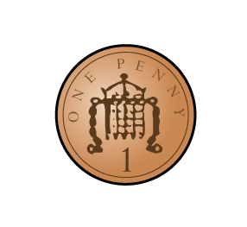
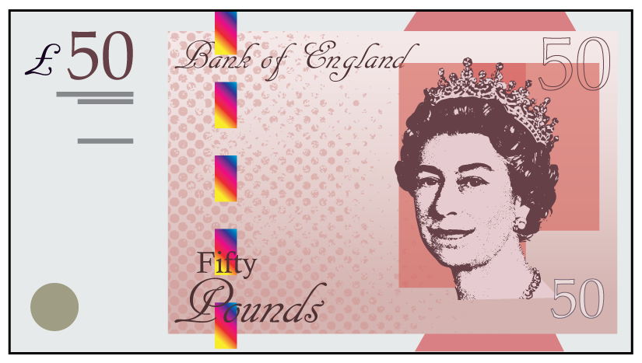

Slide 26
