Slide 3
Draw 4 groups of 6 counters.
2) Draw 6 groups of 4 counters.
3) How many counters did you draw in each question?

Slide 4
Draw 4 groups of 6 counters.
2) Draw 6 groups of 4 counters.
3) How many counters did you draw in each question?
24

Slide 6
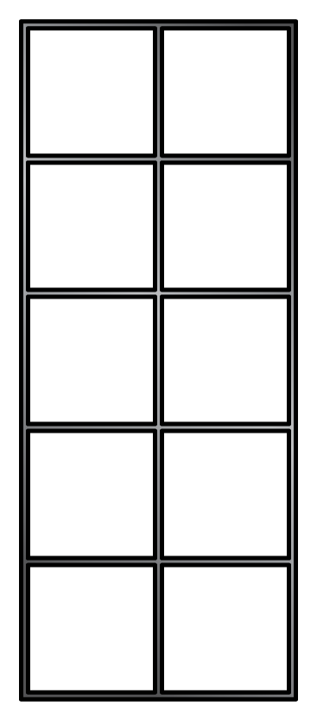
Complete the sentences.
4
There are equal groups with
in each group.
$+$ $+$ $+$ $=$ 24
6
6
6
6
6

Slide 7
Complete the sentences.
Have a think
3
There are equal groups with
in each group.
$+$ $+$ $=$ 15
5
5
5
5

Slide 8
Complete the sentences.
Have a think
6
There are equal groups with
in each group.
There are cubes altogether.
$+$ $+$ $+$ $+$ $+$ $=$
3
18
3
3
3
3
3
3
18

Slide 9
Write a number sentence to
match the cubes.
$+$ $+$ $+$ $+$ $=$
2
2
2
2
2
10
Have a think

Slide 10
Have a go at questions 1 - 2 on the worksheet

Slide 11
Draw cubes to match the number sentence.
$+$ $+$ $=$
4
4
4
12
How many are in each group?
How many groups are there?

Slide 12
Draw cubes to match the number sentence.
3
3
3
3
3
$+$ $+$ $+$ $+$ $=$
15
How many are in each group?
How many groups are there?
Have a think

Slide 13
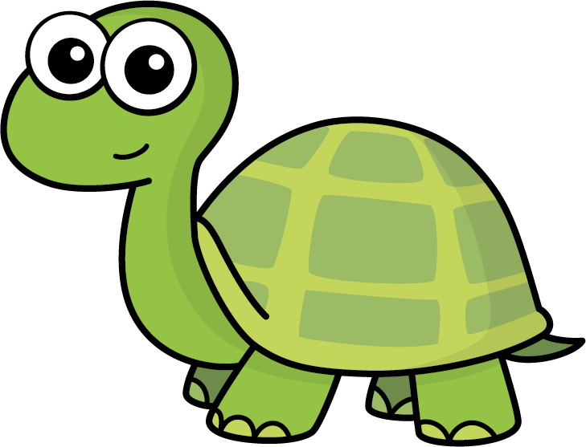
Draw cubes to match the number sentence.
$+$ $=$
5
5
10
Do you agree with Tiny?
There are 2 groups.
There are 5 in each group.
Have a think

Slide 14
Complete the sentences.
$+$ $+$ $=$
6
6
6
18
3
There are equal groups with
in each group.
There are altogether.
6
18
Have a think

Slide 15
Have a go at the rest of the questions on the worksheet

Slide 17
I do
You do

Slide 18
Rosie
Alex
Amir
Whitney
Ron
Dexter
Annie
Tommy
Mo
Jack
Eva
Teddy
Max
Kim
Jo
Sam

Slide 19
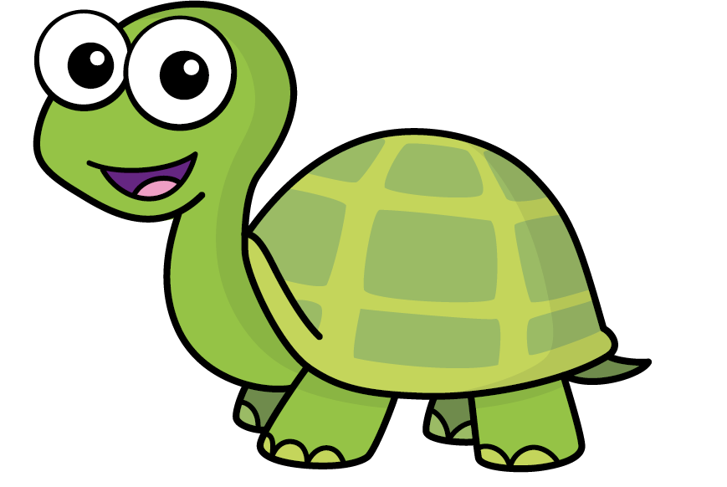
Speech bubble text – replace with any character head.
Speech bubble text – replace with any character head.
Bee
Diddy
Tiny

Slide 20
27
342
300
2
20
7
40
M | HTh | Tth | Th | H | T | O

Slide 21
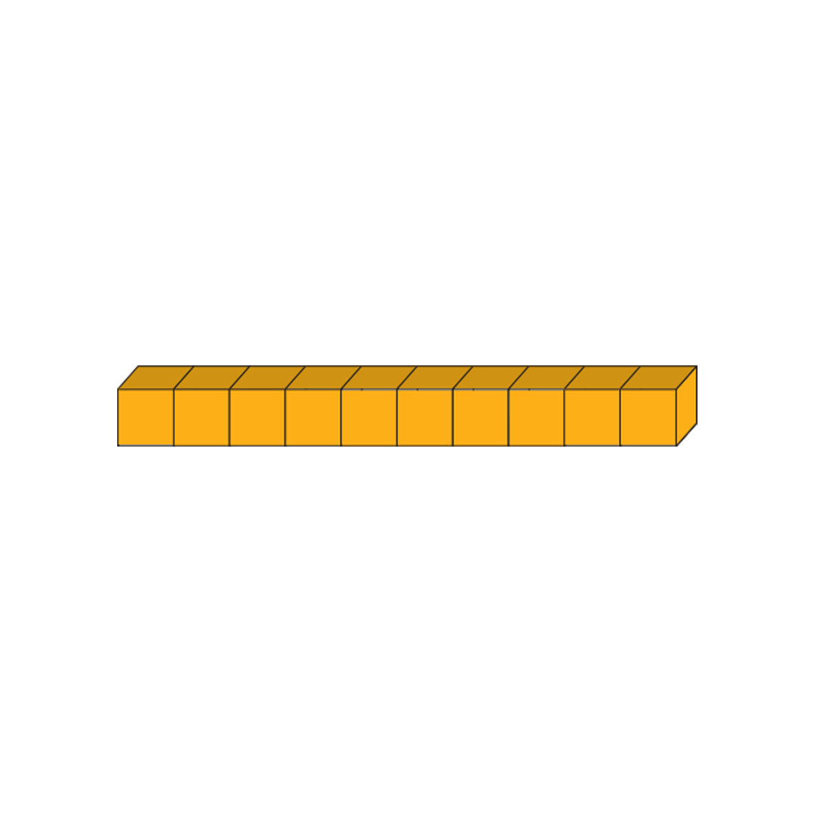
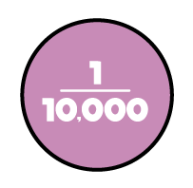
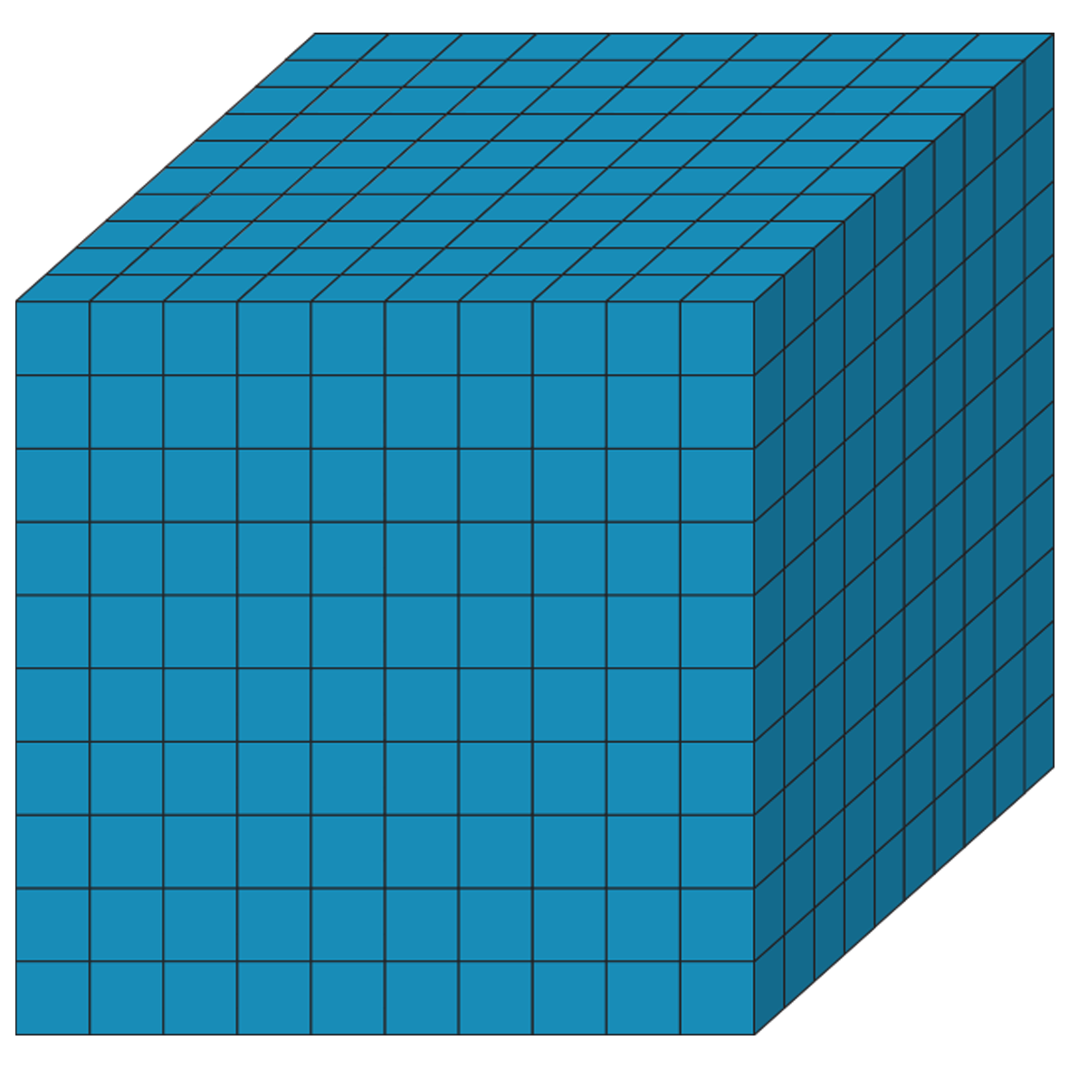
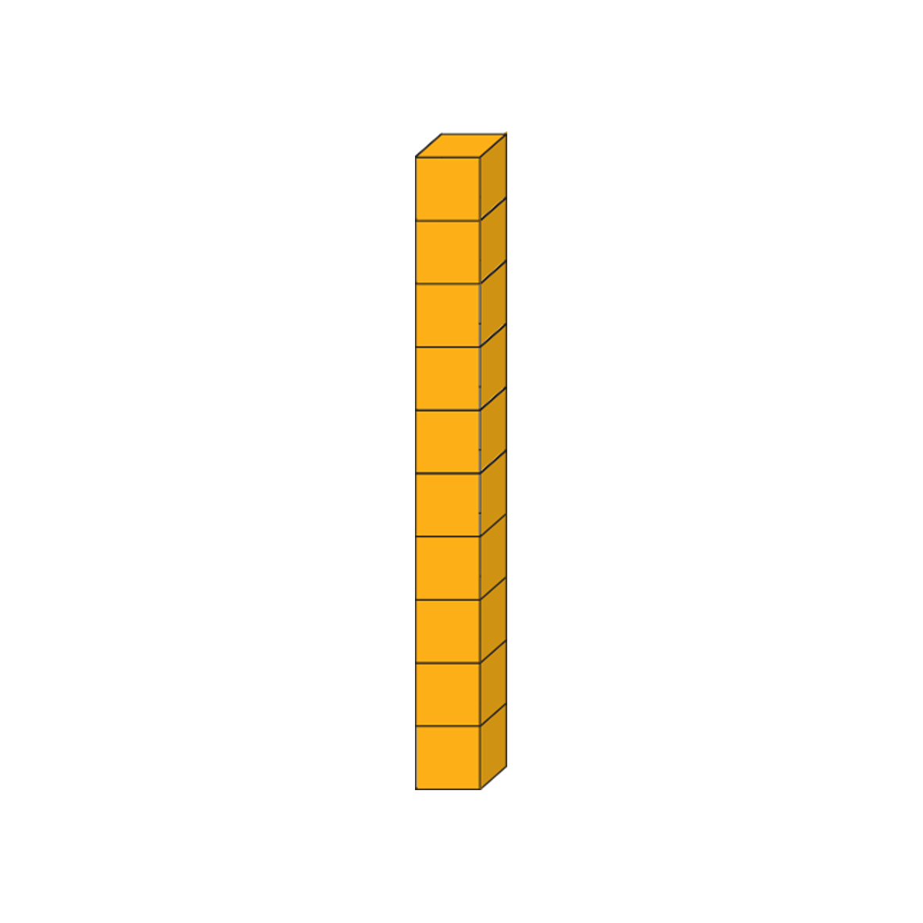
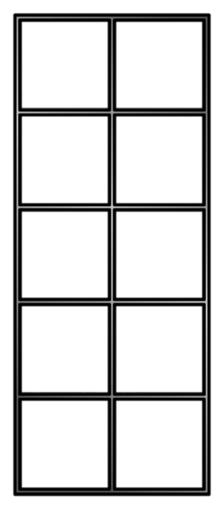
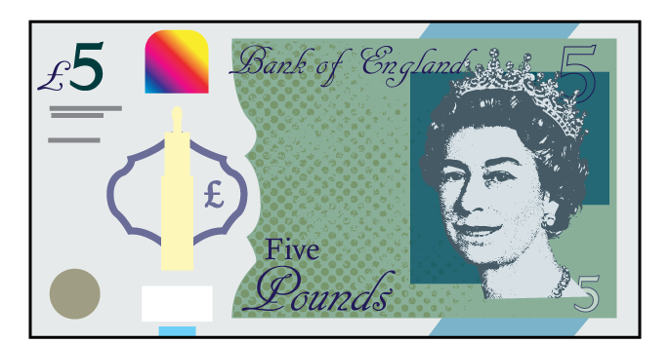
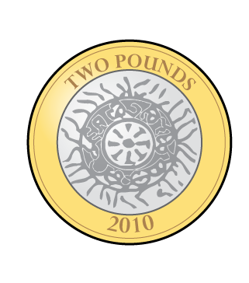
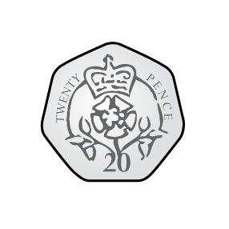
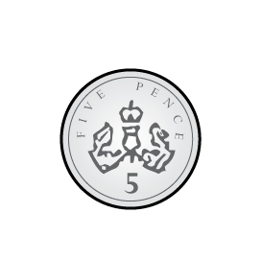
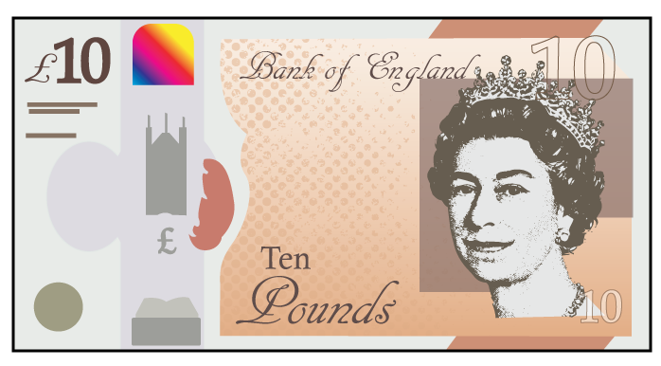
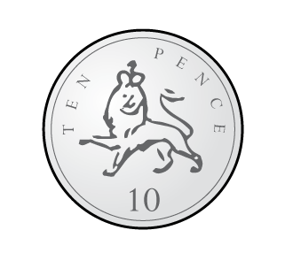
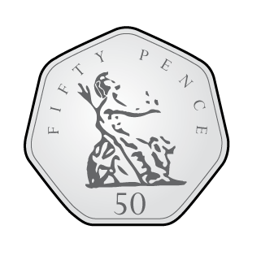
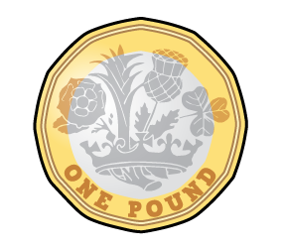
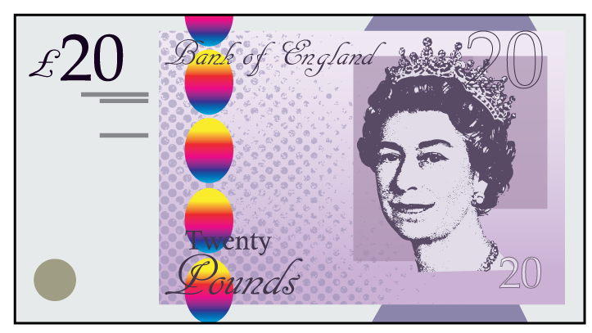
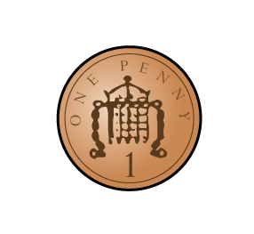
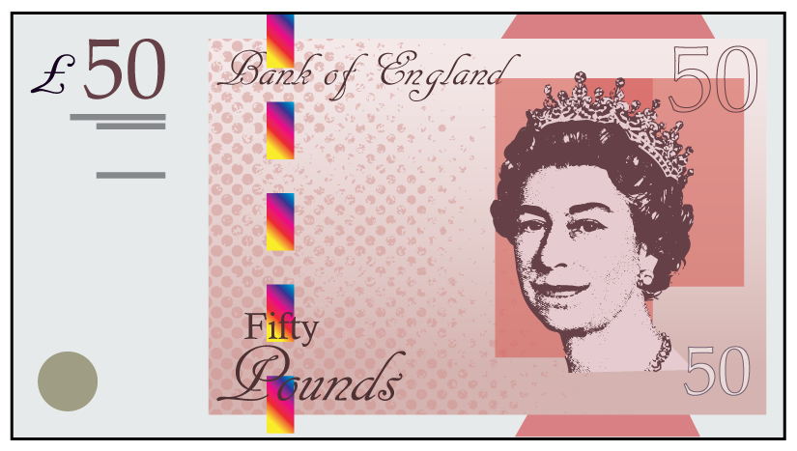

Slide 22
