Slide 3
How many pairs of mittens are there?
2) Complete the number track.
3) How many counters altogether?
3 | 6 | 9

Slide 4
How many pairs of mittens are there?
2) Complete the number track.
3) How many counters altogether?
3
3 | 6 | 9
12
15
8

Slide 6
Are the groups equal or unequal?
How do you know?
The groups are equal.
There are 5 cubes in each group.

Slide 7
Are the groups equal or unequal?
How do you know?
The groups are unequal.
There are a different number of
cubes in each group.
Have a think

Slide 8
Are the groups equal or unequal?
How do you know?
The groups are equal.
There are 2 cubes in each group.
Does it matter if the groups look different?
Have a think

Slide 9
Complete the sentences.
There are groups of
There are counters altogether.
3
4
12

Slide 10
Complete the sentences.
There are groups of
There are counters altogether.
5
3
15
Have a think

Slide 11
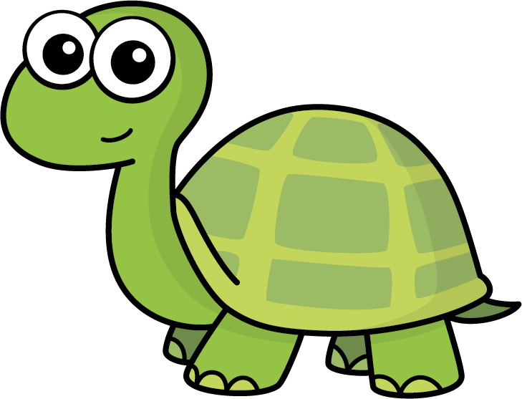
Do you agree with Tiny?
No
There are 4 groups of 2
There are 7 counters altogether.
Have a think

Slide 12
Have a go at questions 1 -2 on the worksheet

Slide 13
Complete the equal groups and the sentences.
There are equal groups.
There are in each group.
3
6

Slide 14
Complete the equal groups and the sentences.
There are equal groups.
There are in each group.
6
3
Have a think

Slide 15
Have a think
What’s the same? What’s different?
Complete the sentences.
There are groups of
There are counters altogether.
4
2
8
There are groups of
There are counters altogether.
2
4
8

Slide 16
Have a go at the rest of the questions on the worksheet

Slide 18
I do
You do

Slide 19
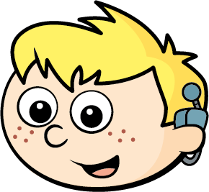
Rosie
Alex
Amir
Whitney
Ron
Dexter
Annie
Tommy
Mo
Jack
Eva
Teddy
Max
Kim
Jo
Sam

Slide 20
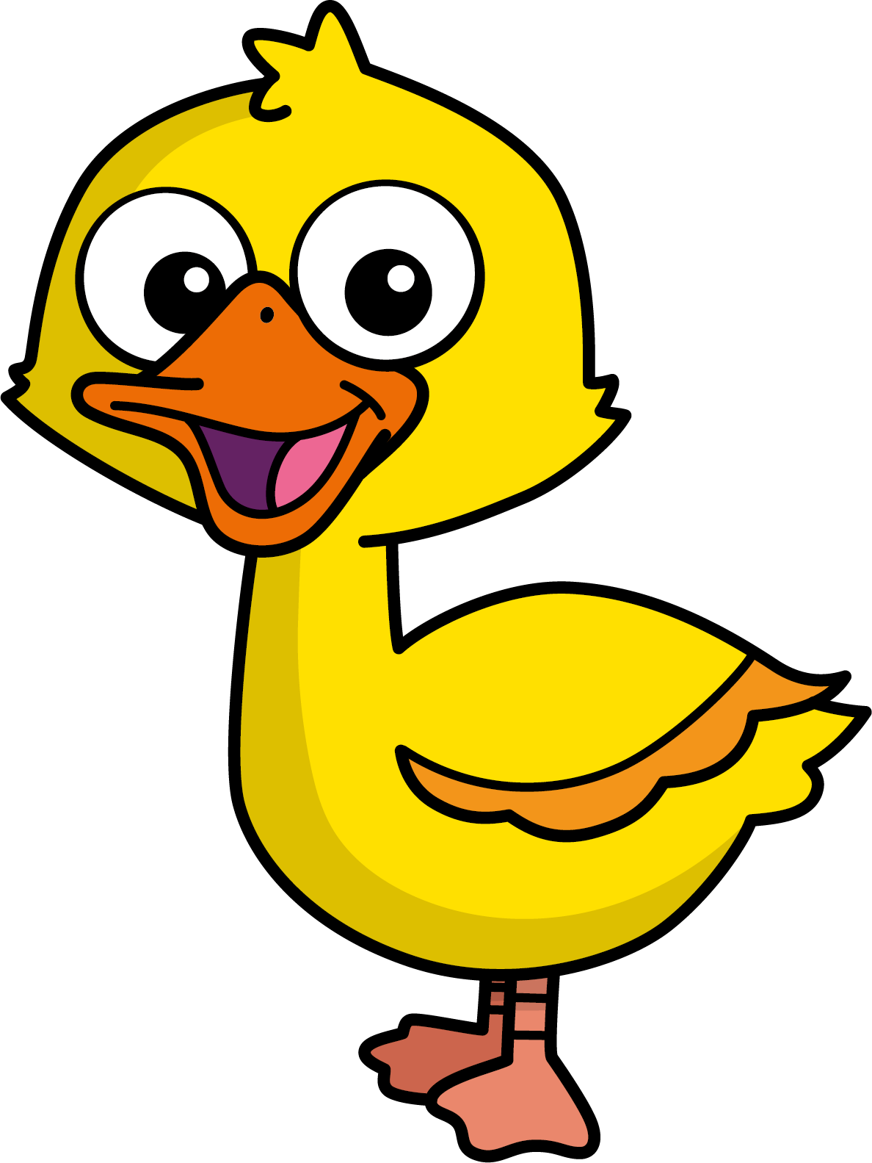
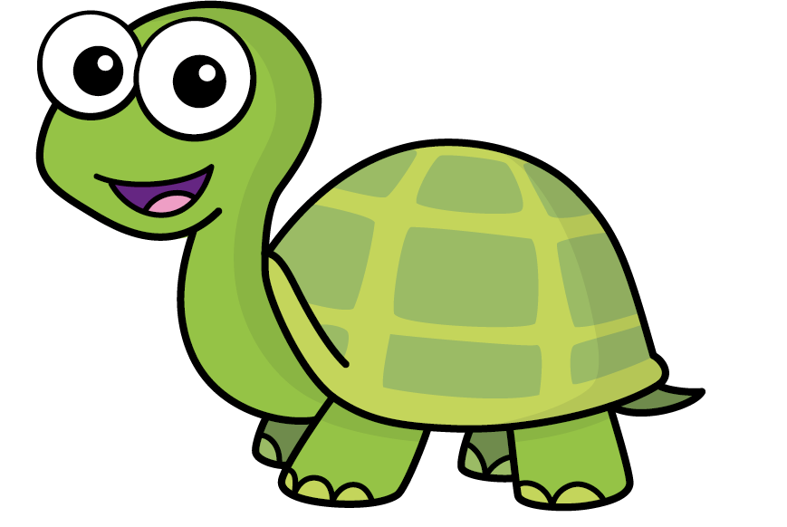
Speech bubble text – replace with any character head.
Speech bubble text – replace with any character head.
Bee
Diddy
Tiny

Slide 21
27
342
300
2
20
7
40
M | HTh | Tth | Th | H | T | O

Slide 22
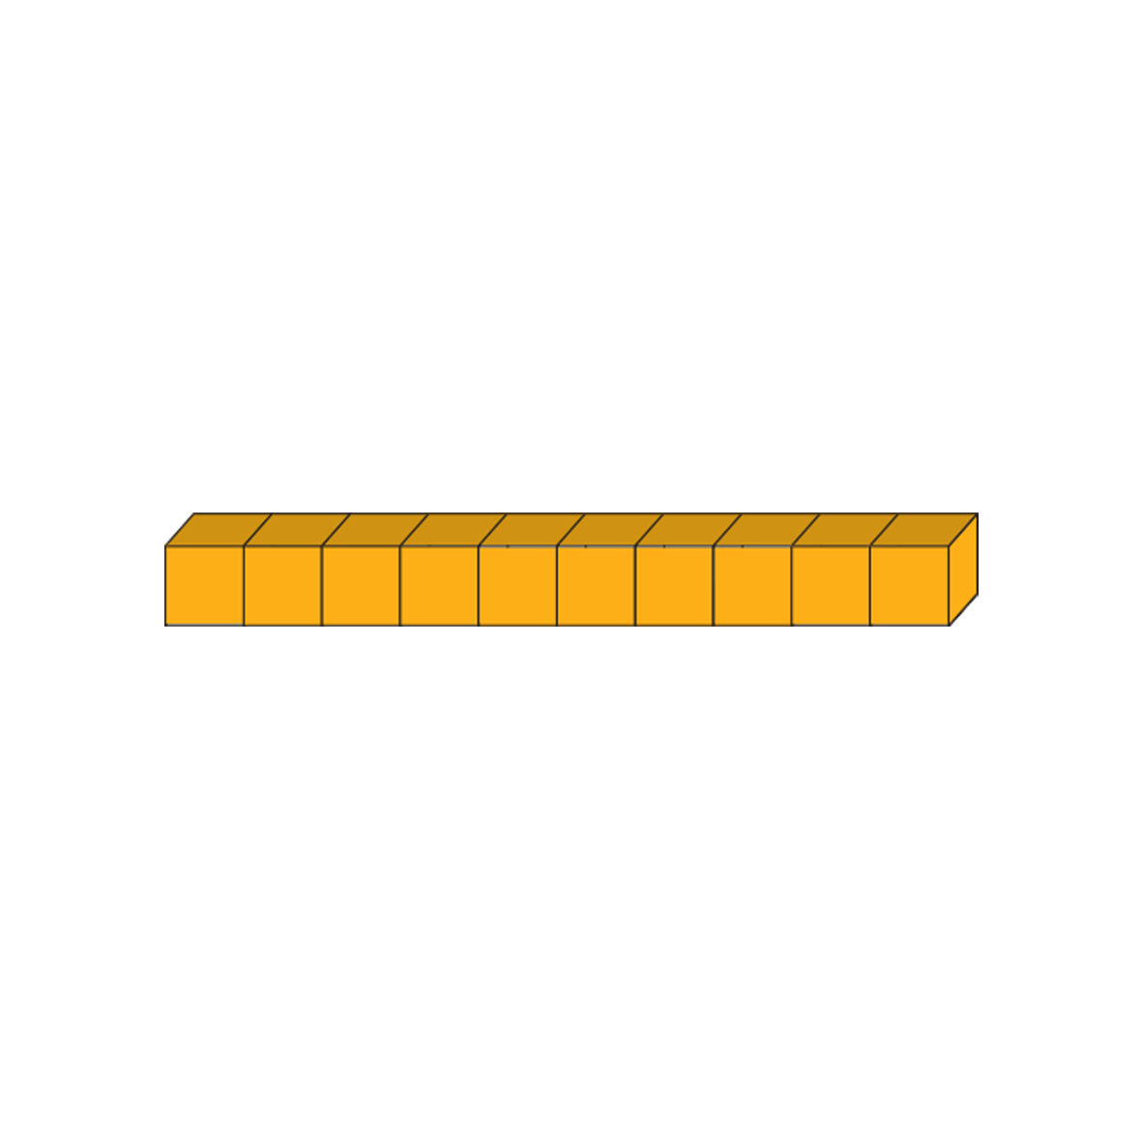
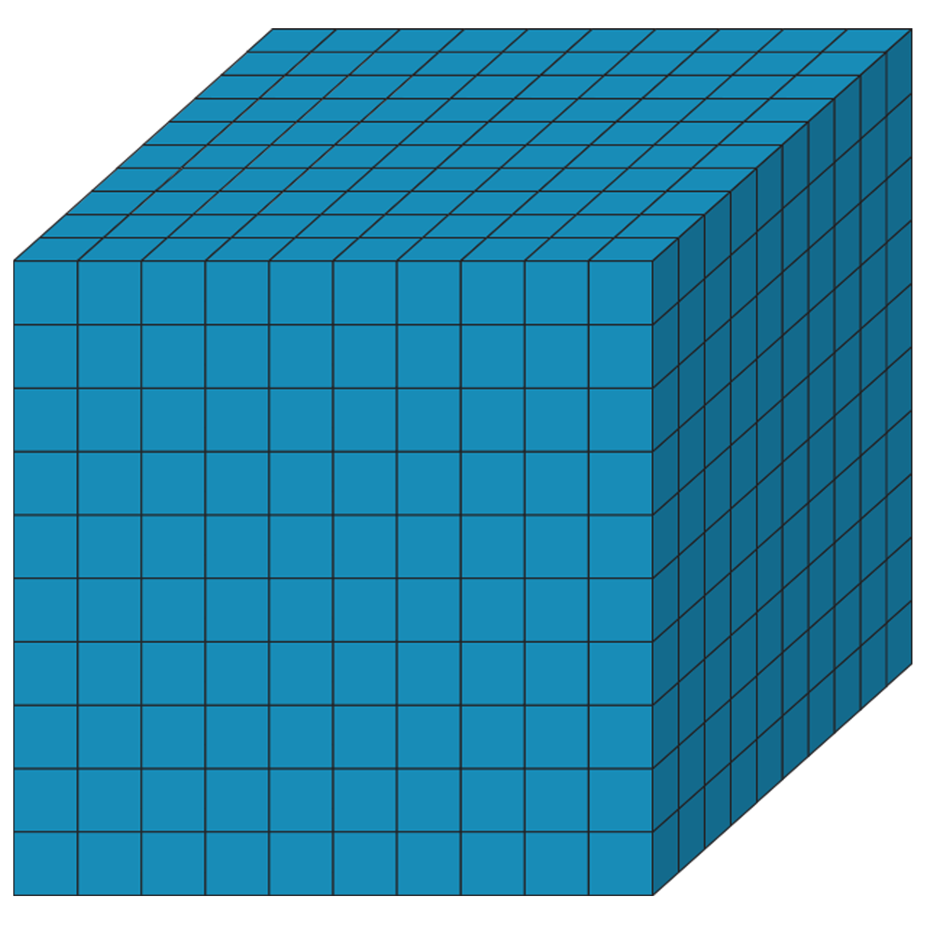
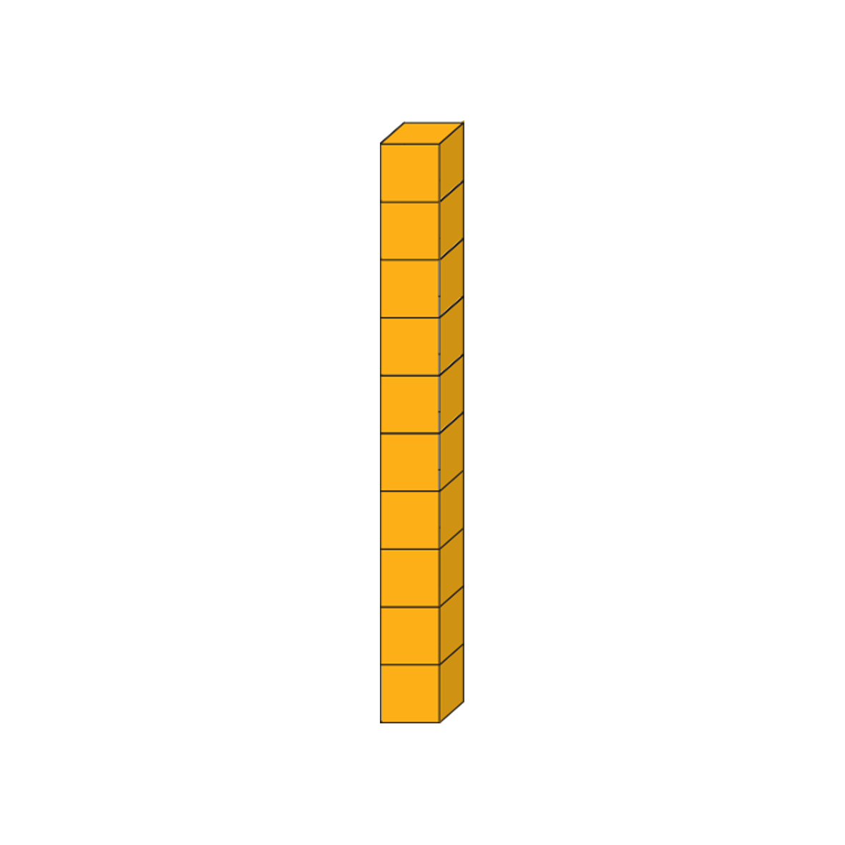
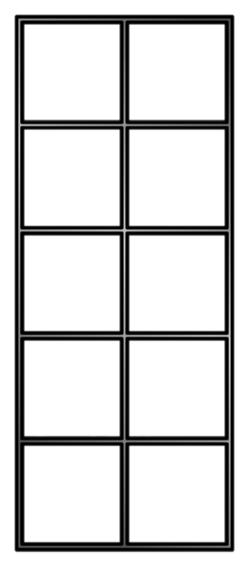
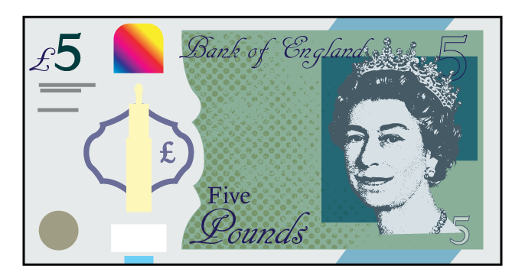
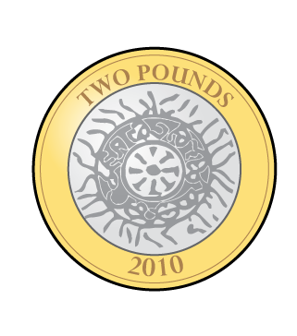
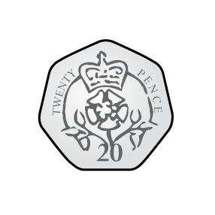
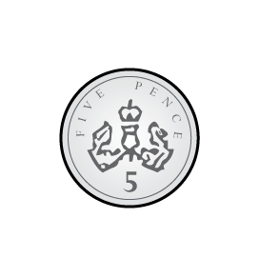
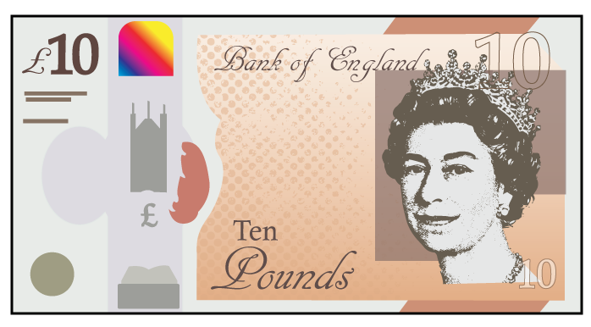
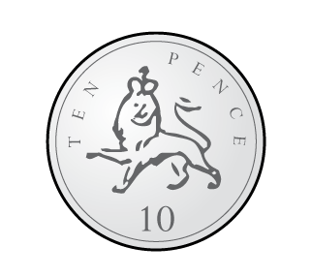
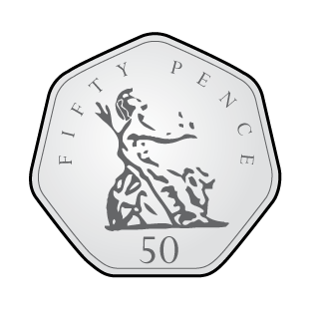
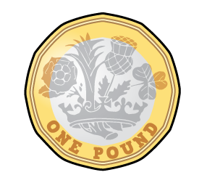
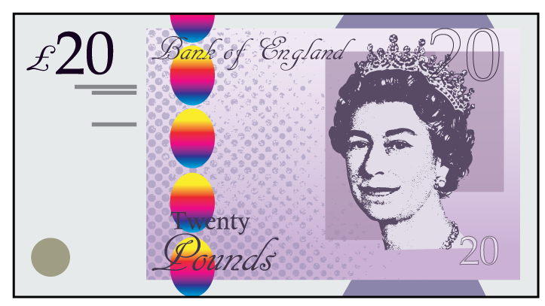
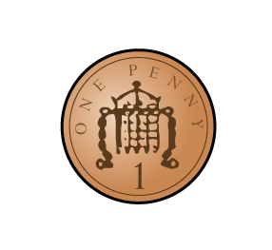
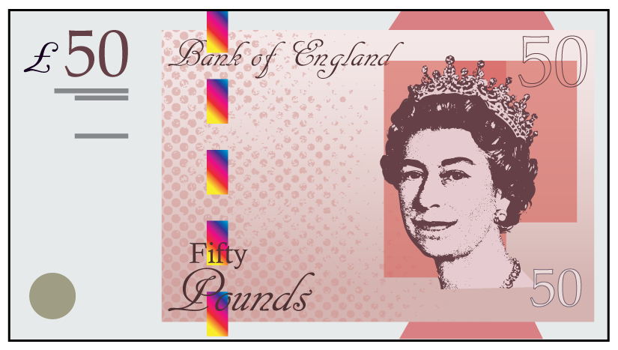

Slide 23
